Slide 2
Overview
To work with Kubernetes, you use Kubernetes API objects to describe your cluster’s desired state: what applications or other workloads you want to run, what container images they use, the number of replicas, what network and disk resources you want to make available, and more. You set your desired state by creating objects using the Kubernetes API, typically via the command-line interface, kubectl. You can also use the Kubernetes API directly to interact with the cluster and set or modify your desired state.

Slide 3
The Kubernetes Master is a collection of three processes that run on a single node in your cluster, which is designated as the master node. Those processes are: kube-apiserver, kube-controller-manager and kube-scheduler.
Each individual non-master node in your cluster runs two processes:
kubelet, which communicates with the Kubernetes Master.
kube-proxy, a network proxy which reflects Kubernetes networking services on each node.

Slide 4
The REST API is the fundamental fabric of Kubernetes. All operations and communications between components, and external user commands are REST API calls that the API Server handles. Consequently, everything in the Kubernetes platform is treated as an API object and has a corresponding entry in the API.
Most operations can be performed through the kubectl command-line interface or other command-line tools, such as kubeadm, which in turn use the API. However, you can also access the API directly using REST calls

Slide 5
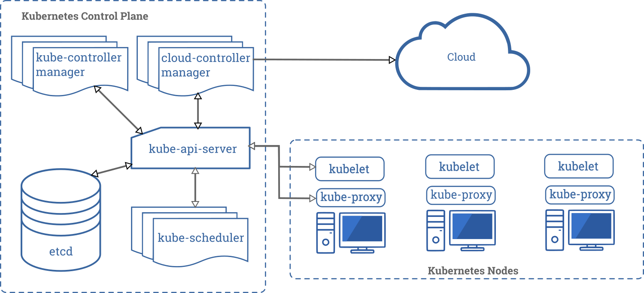

Slide 6
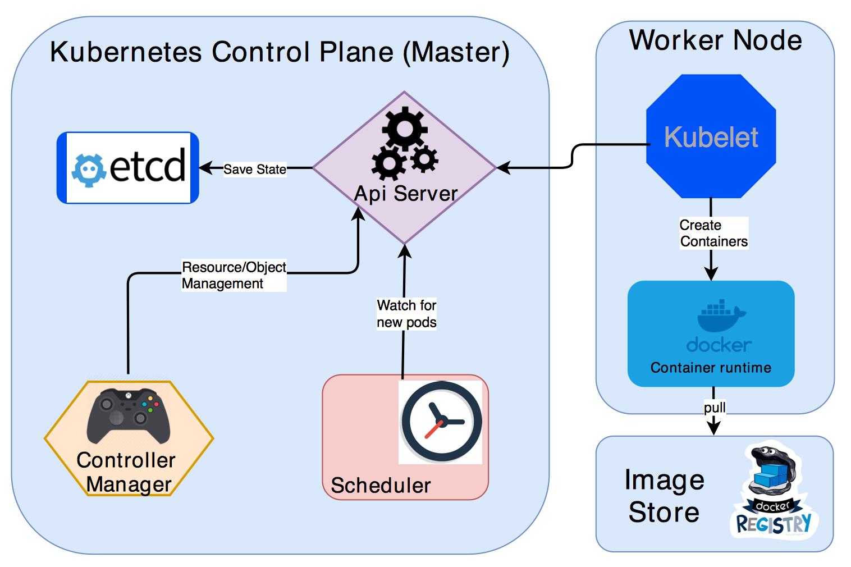

Slide 7
A Kubernetes cluster consists of two main components:
Master (Control Plane)
Worker Nodes.
Control Plane has following components. These components are responsible for maintaining the state of the cluster:
etcd distributed key value store.
API Server.
Controller Manager
Scheduler
Every worker node consists of the following components. These components are responsible for deploying and running the application containers.
Kubelet
Container Runtime (Docker)

Slide 8
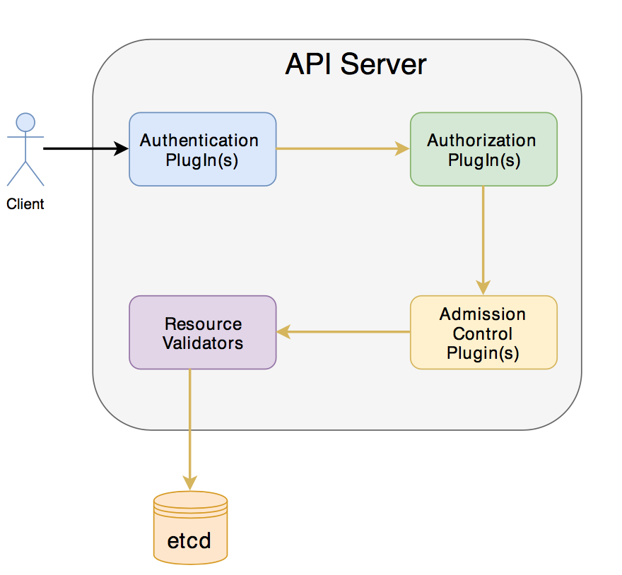
kube-apiserver
The API server is a component of the Kubernetes control plane that exposes the Kubernetes API. The API server is the front end for the Kubernetes control plane.
The main implementation of a Kubernetes API server is kube-apiserver. kube-apiserver is designed to scale horizontally—that is, it scales by deploying more instances. You can run several instances of kube-apiserver and balance traffic between those instances.

Slide 9
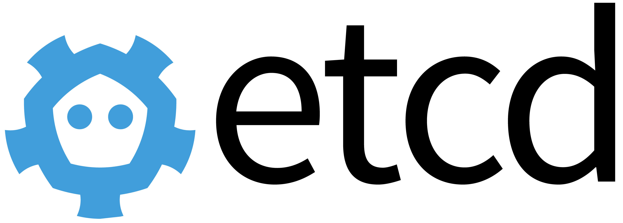
etcd:
Kubernetes use etcd for storing the cluster status and metadata, which includes creation of any objects (pods, deployments, replication controllers, ingress etc…). etcd is a distributed key value store that provides reliable way of storing data across a cluster of machines. As mentioned in the diagram API Server is the single entry point that can directly talk to etcd store. Any other control plane component will go through API Server only. K8s stores all its data under /registry directory in etcd.

Slide 10
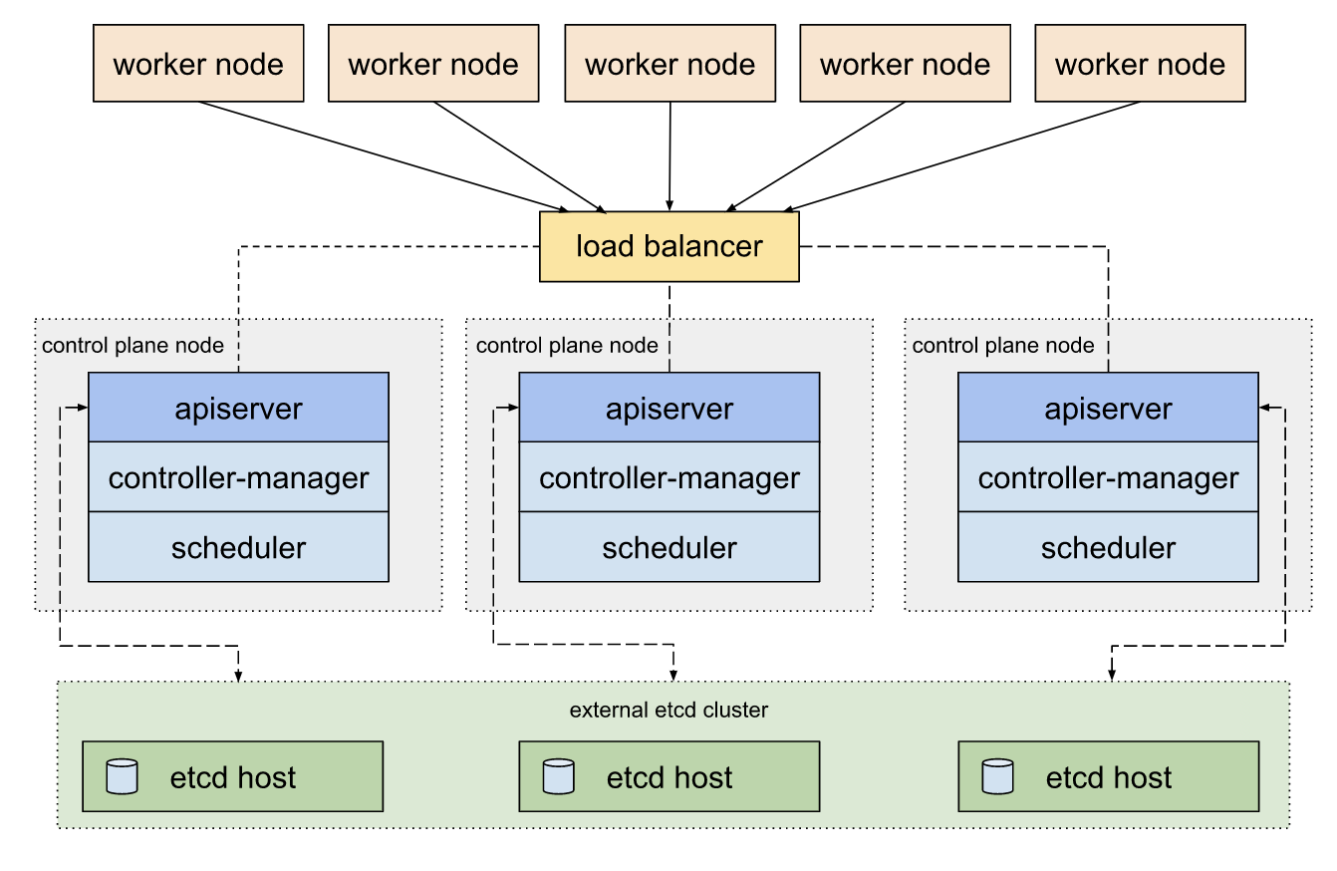

Slide 11
kube-scheduler
The scheduler’s main job is to allocate what node the pods needs to be created. It registers with Api Server for any newly created object/resource.
Scheduler figures out what node the pods needs to be created, using an algorithm. It checks whether the worker node has desired capacity or not. It checks whether the resource specification targeted any specific nodes with labels or affinity rules or any specific volumes like SSD. Finally after figuring out the node the scheduler will just update the resource specification and send it API Server. The Api Server updates the resource specification and stores into etcd. The Api Server notifies the kubelet for the worker node selected by schedule

Slide 12
kube-controller-manager
Control Plane component that runs controller processes.
Logically, each controller is a separate process, but to reduce complexity, they are all compiled into a single binary and run in a single process.
These controllers include:
Node controller: Responsible for noticing and responding when nodes go down.
Replication controller: Responsible for maintaining the correct number of pods for every replication controller object in the system.
Endpoints controller: Populates the Endpoints object (that is, joins Services & Pods).
Service Account & Token controllers: Create default accounts and API access tokens for new namespaces.

Slide 13
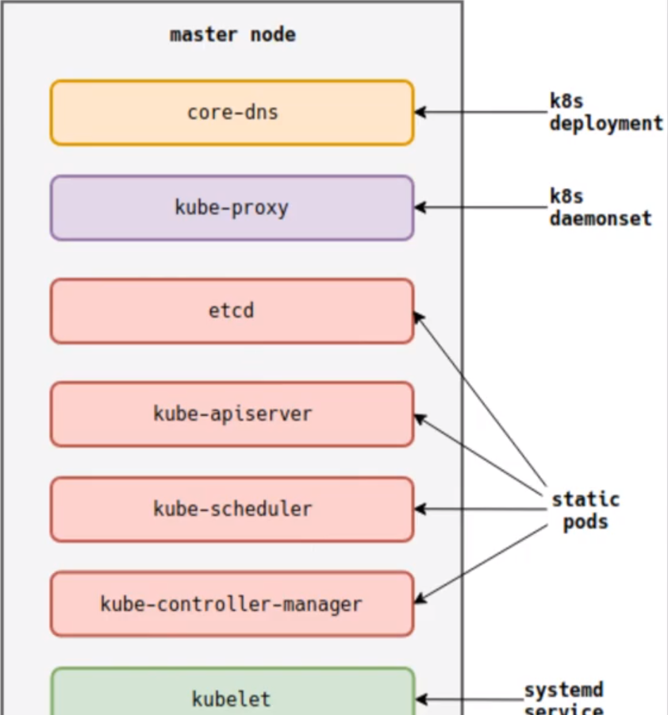

Slide 14
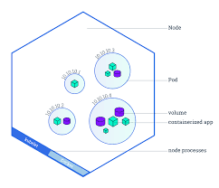
Nodes
A Pod always runs on a Node. A Node is a worker machine in Kubernetes and may be either a virtual or a physical machine, depending on the cluster. Each Node is managed by the Master. A Node can have multiple pods, and the Kubernetes master automatically handles scheduling the pods across the Nodes in the cluster. The Master's automatic scheduling takes into account the available resources on each Node.
Every Kubernetes Node runs at least:
Kubelet, a process responsible for communication between the Kubernetes Master and the Node; it manages the Pods and the containers running on a machine.
A container runtime (like Docker, rkt) responsible for pulling the container image from a registry, unpacking the container, and running the application.
Containers should only be scheduled together in a single Pod if they are tightly coupled and need to share resources such as disk.

Slide 15
kubectl get - list resources
kubectl describe - show detailed information about a resource
kubectl logs - print the logs from a container in a pod
kubectl exec - execute a command on a container in a pod

Slide 16
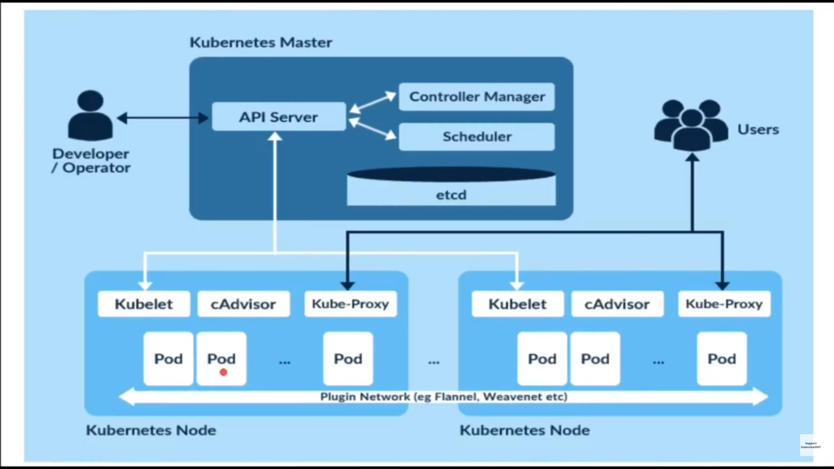

Slide 17
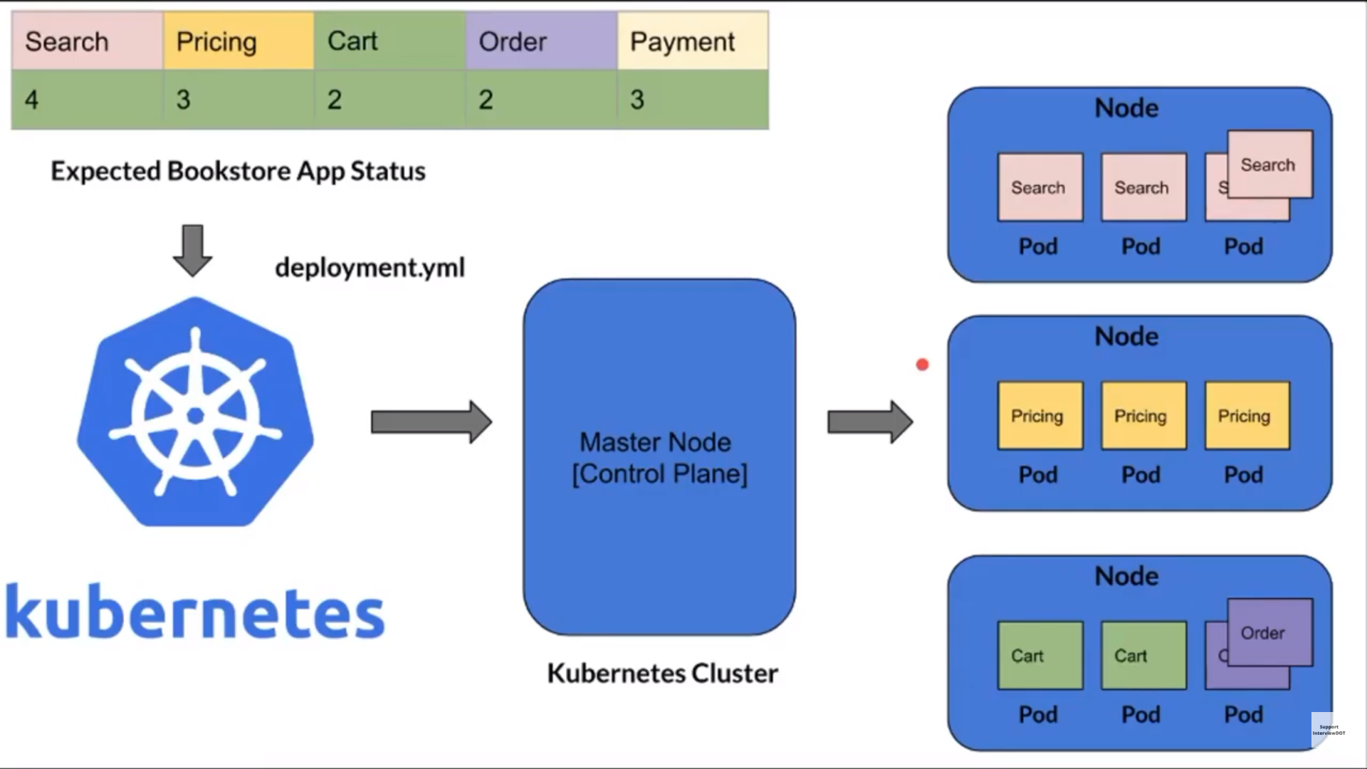

Slide 18
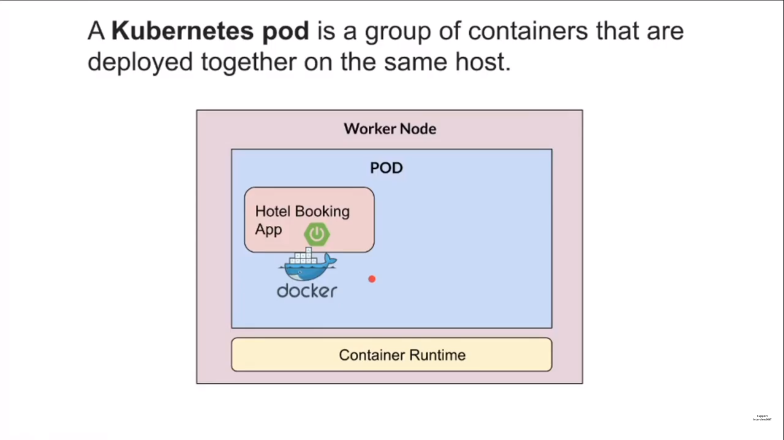

Slide 19
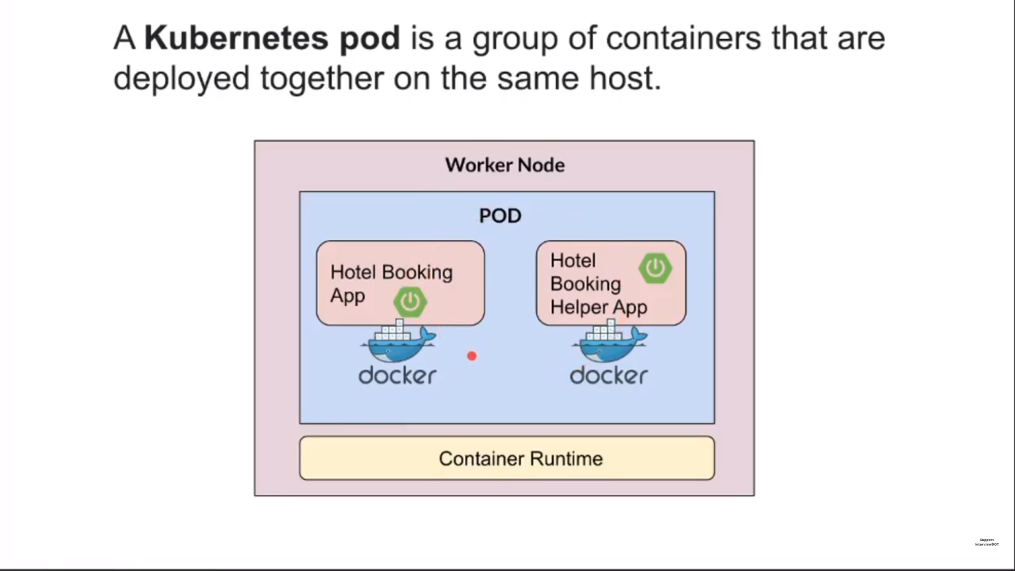

Slide 20
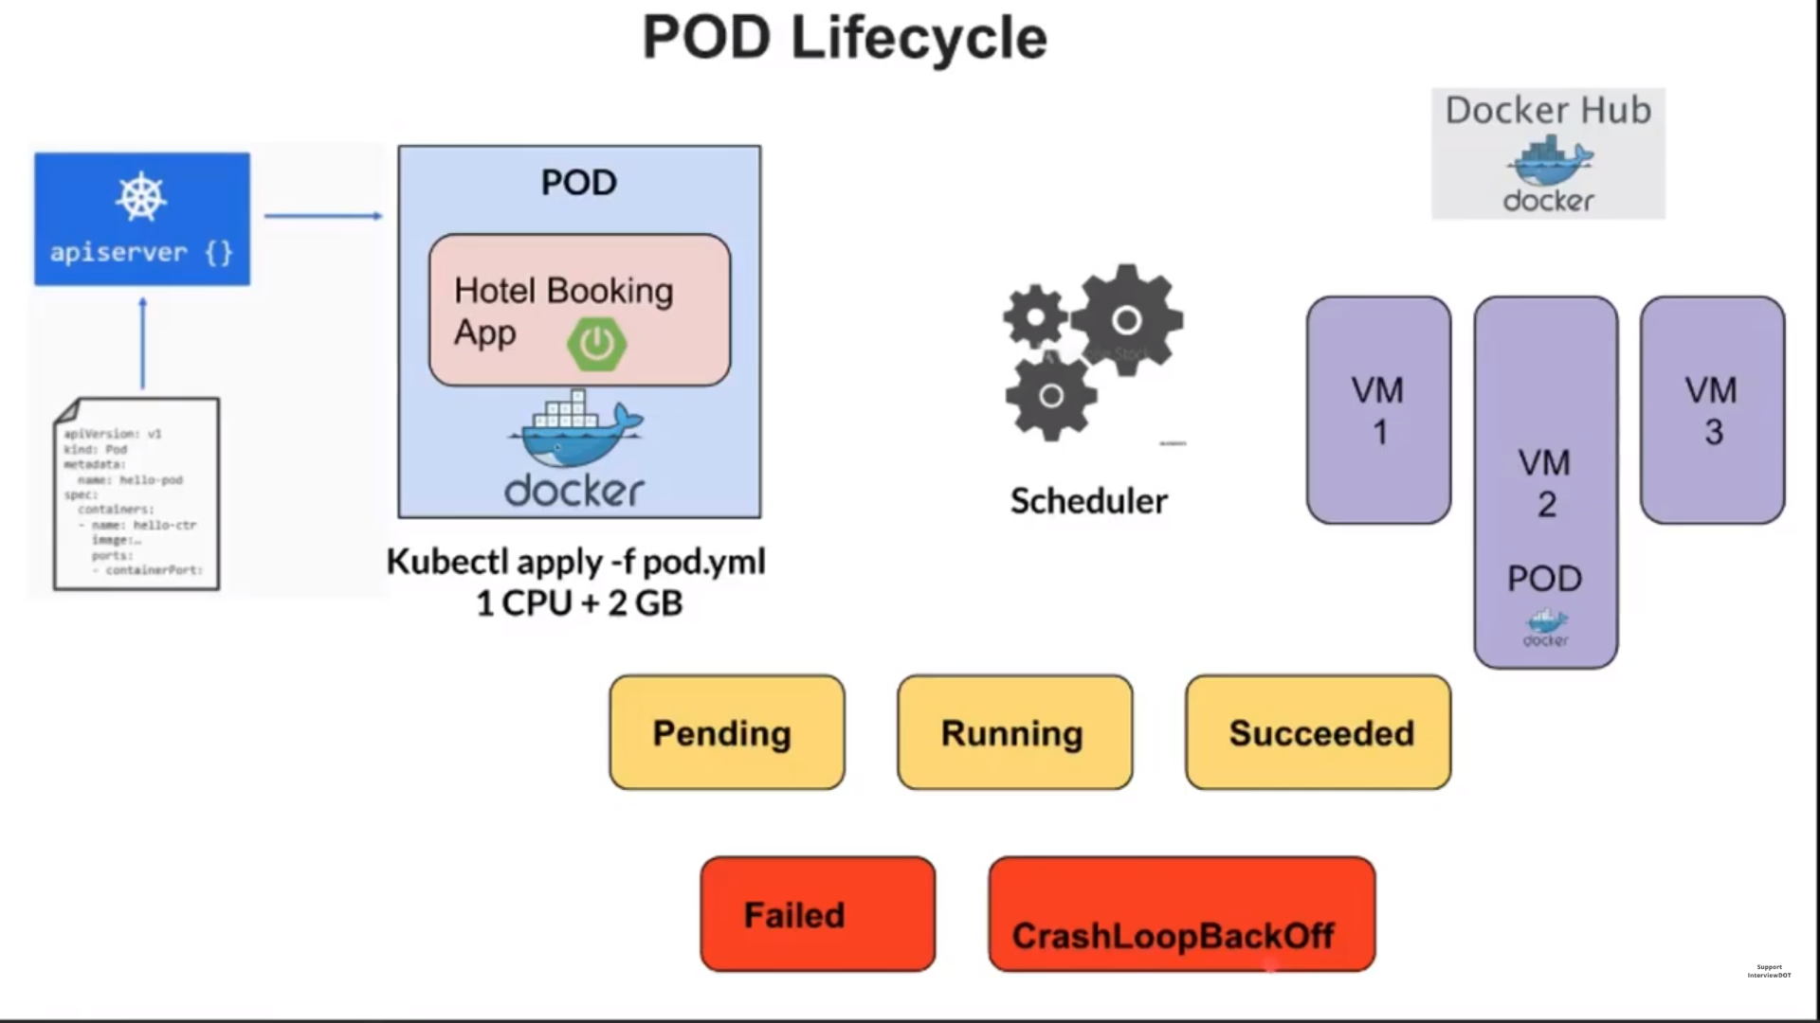

Slide 21
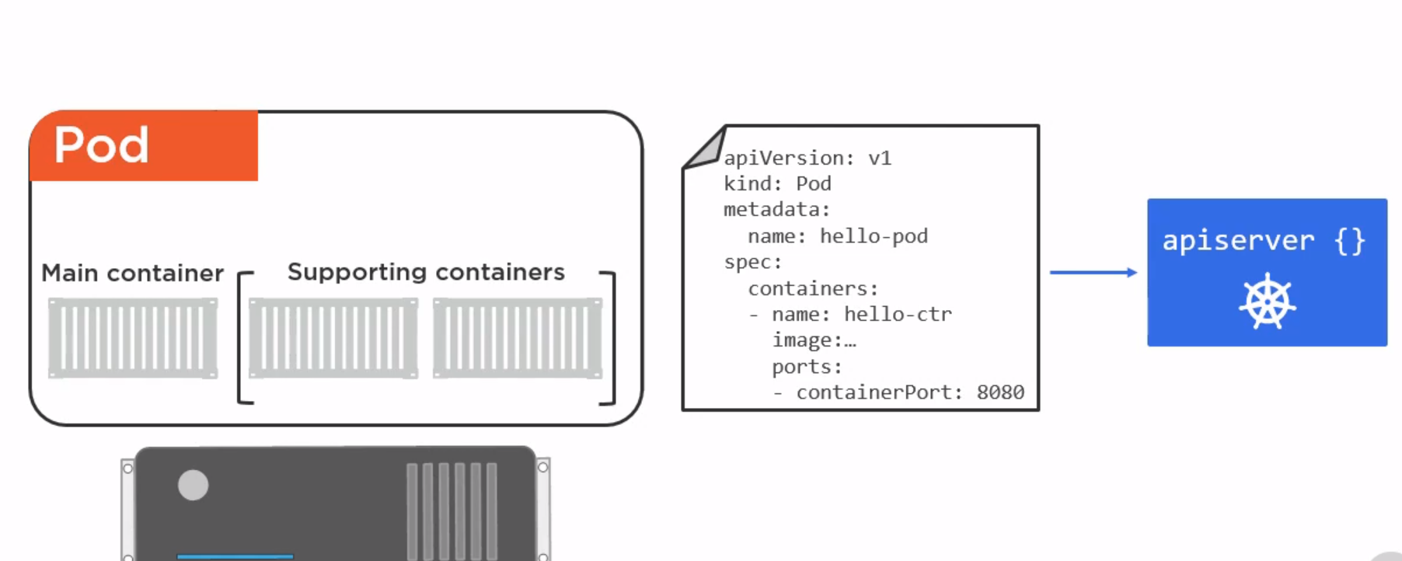

Slide 22
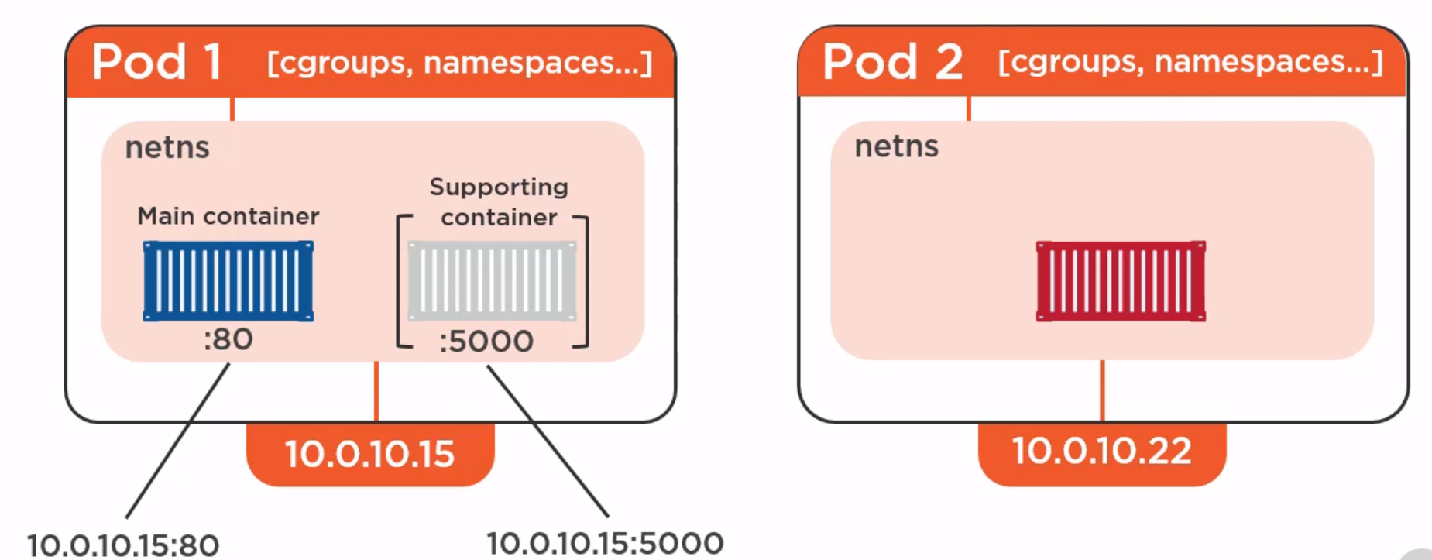

Slide 23
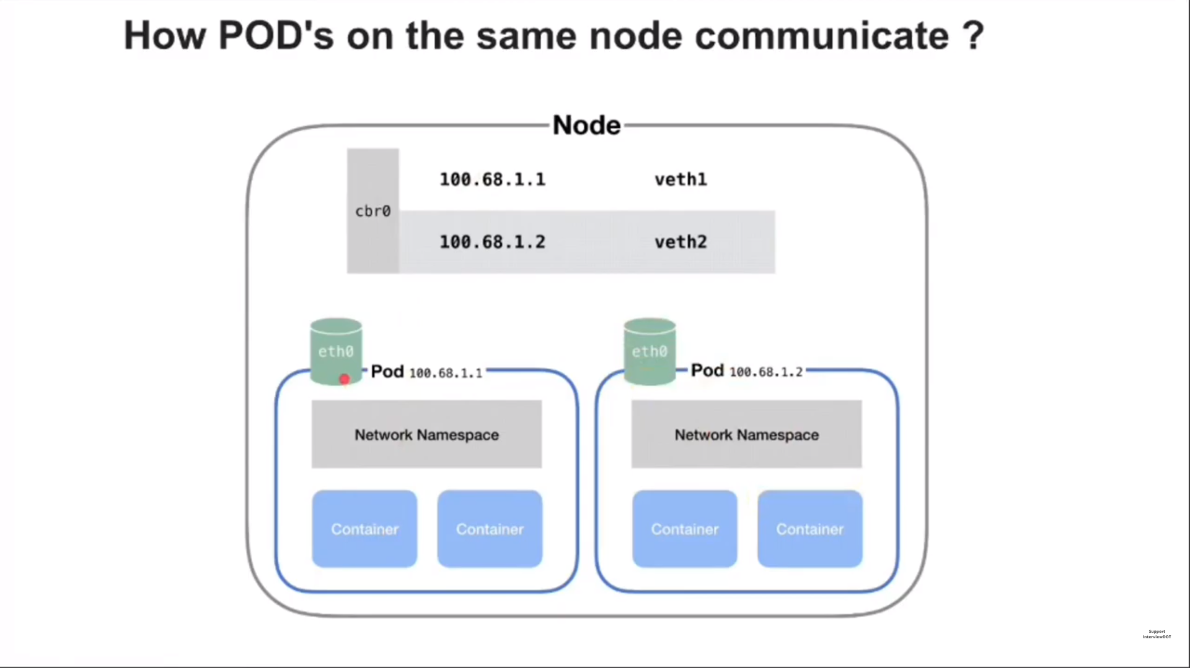

Slide 24
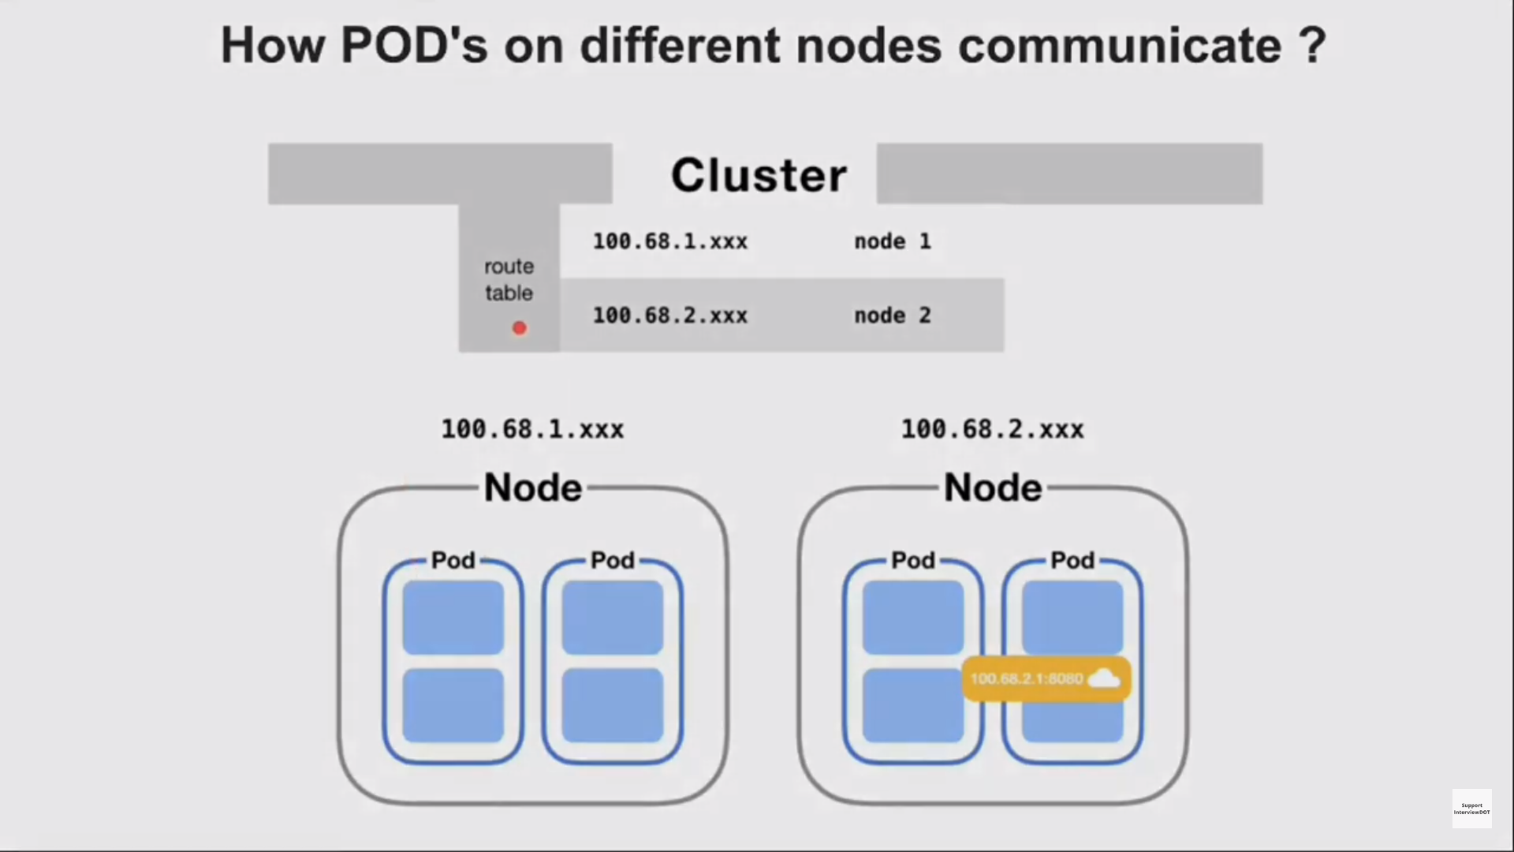

Slide 25
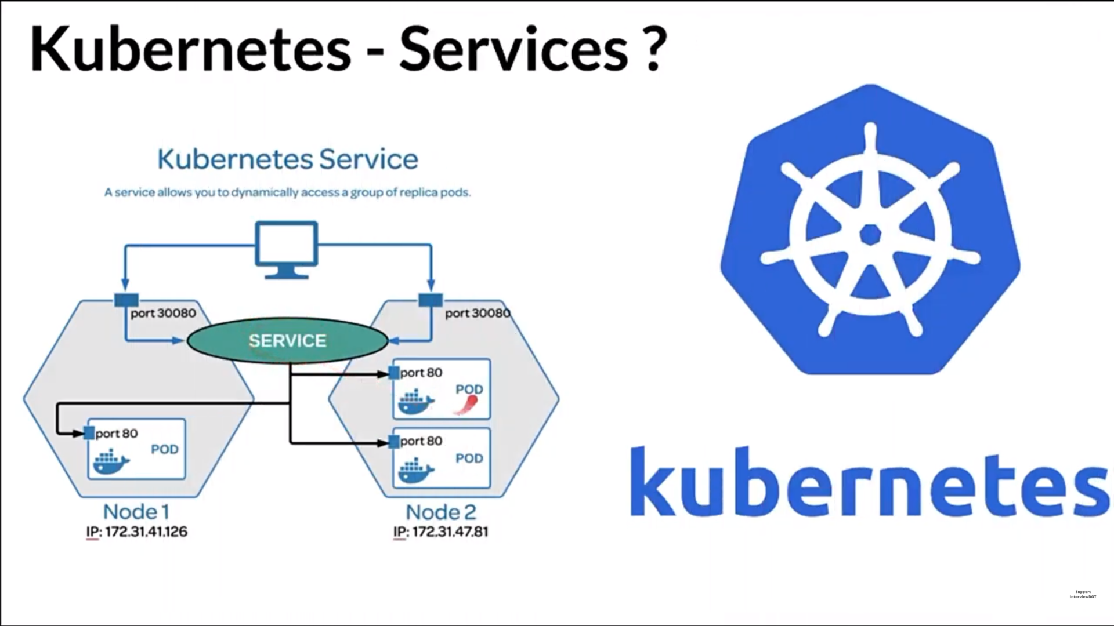

Slide 26
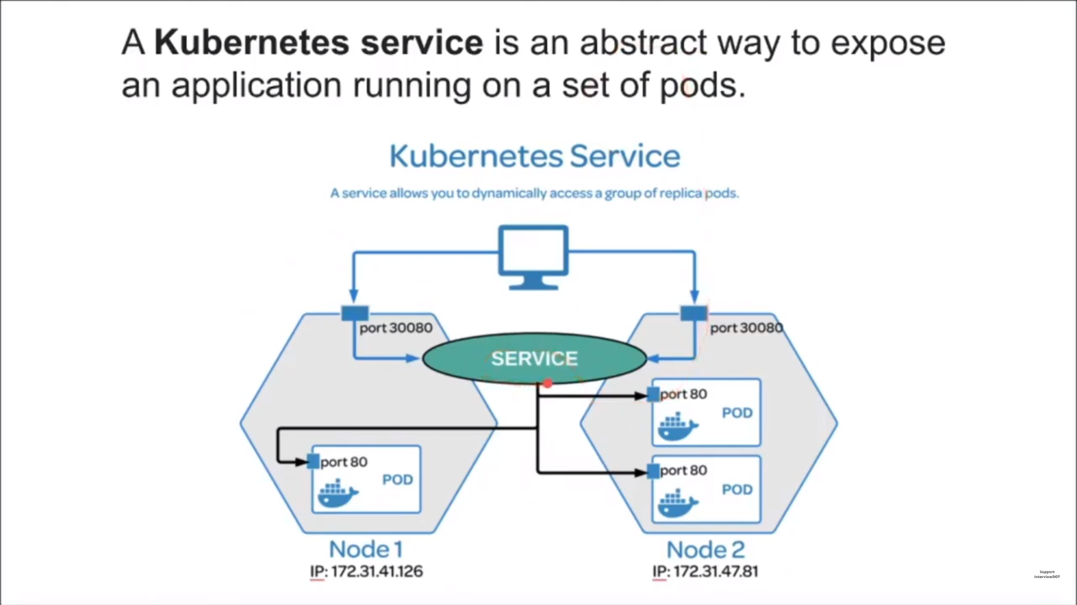

Slide 27
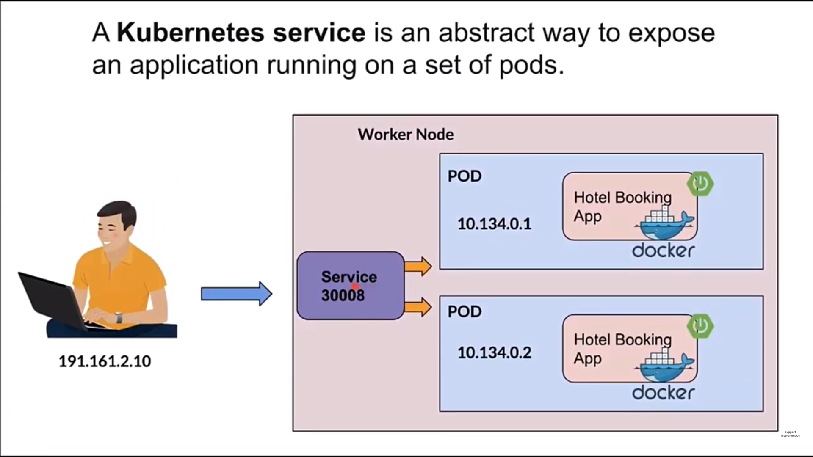

Slide 28
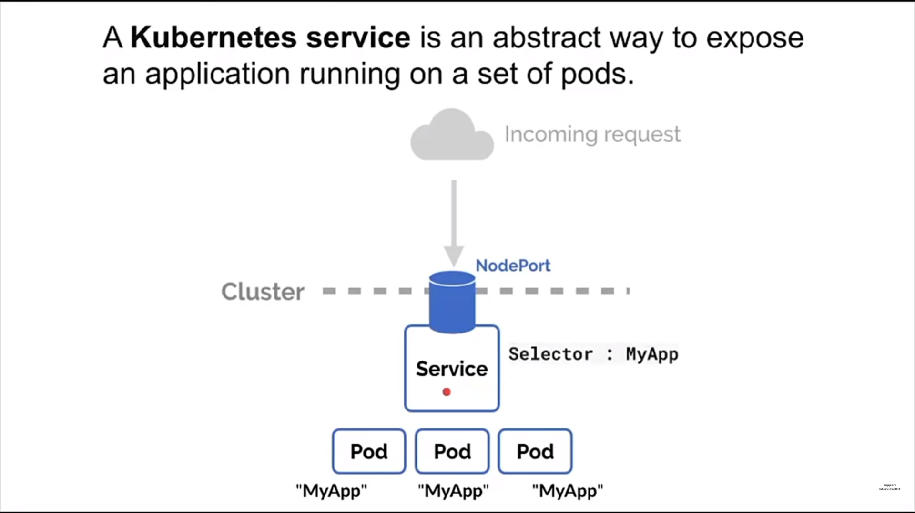

Slide 29
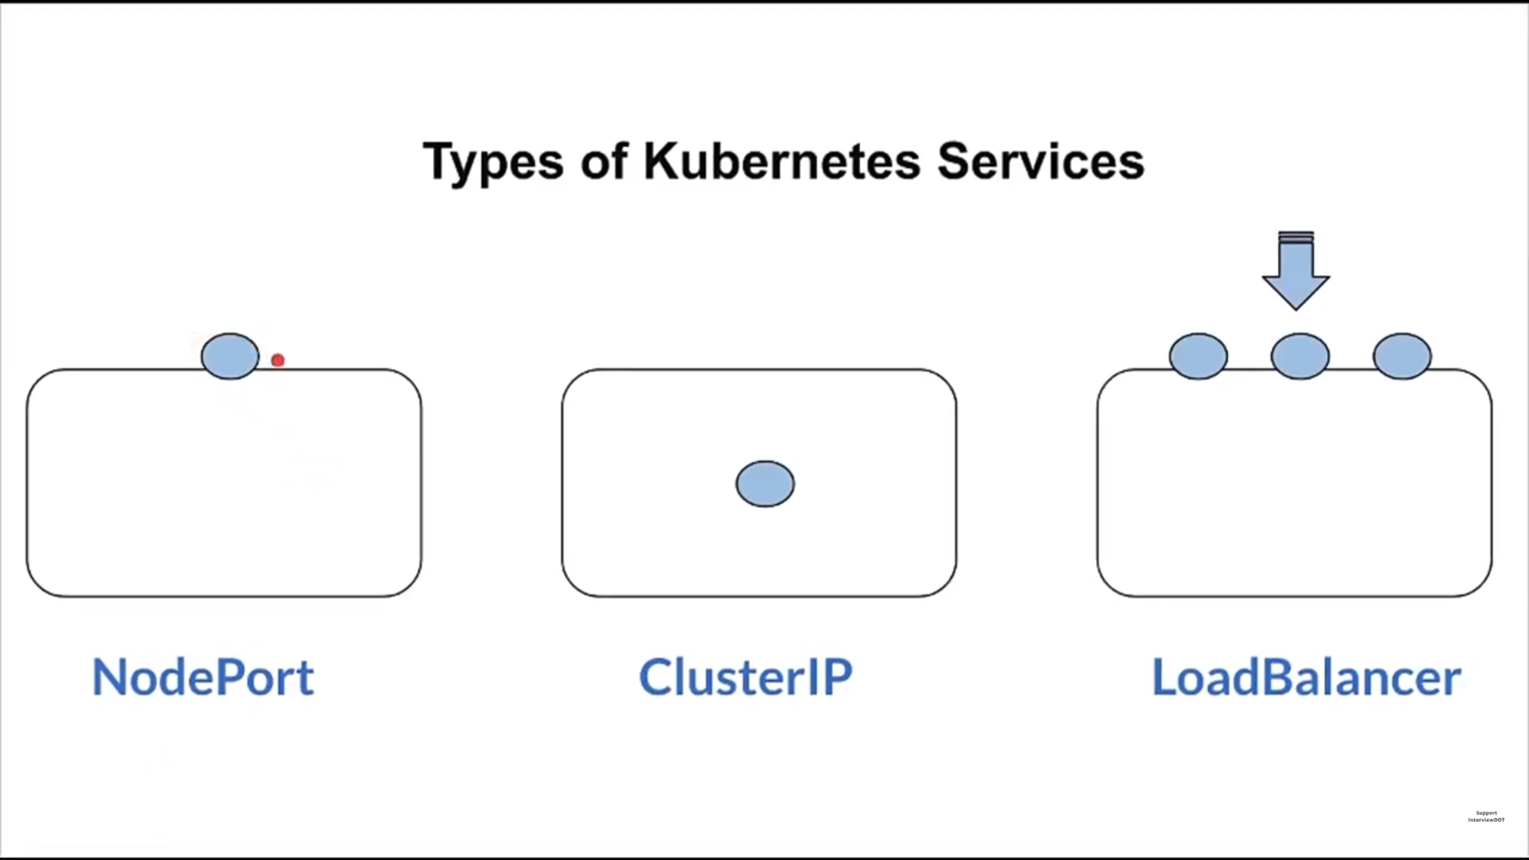

Slide 30
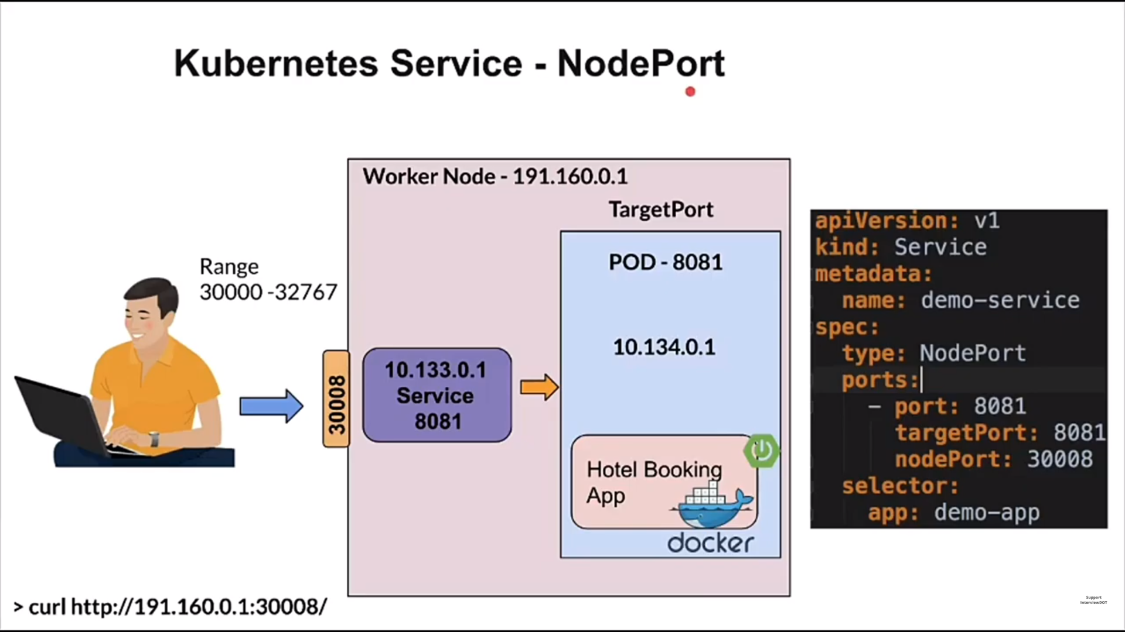

Slide 31
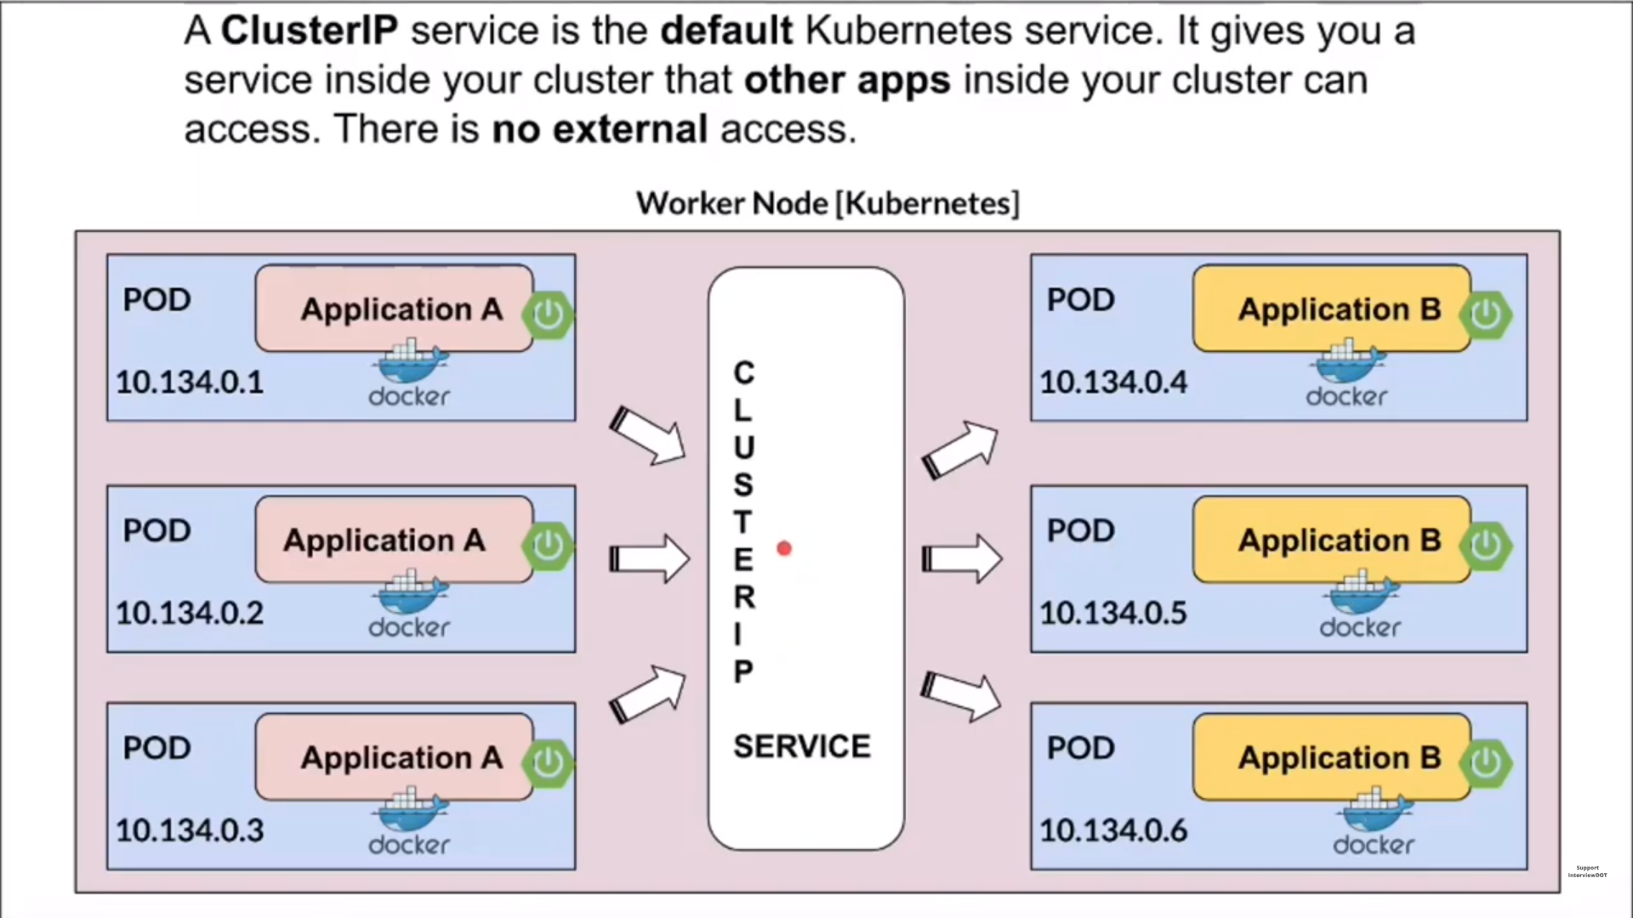

Slide 32
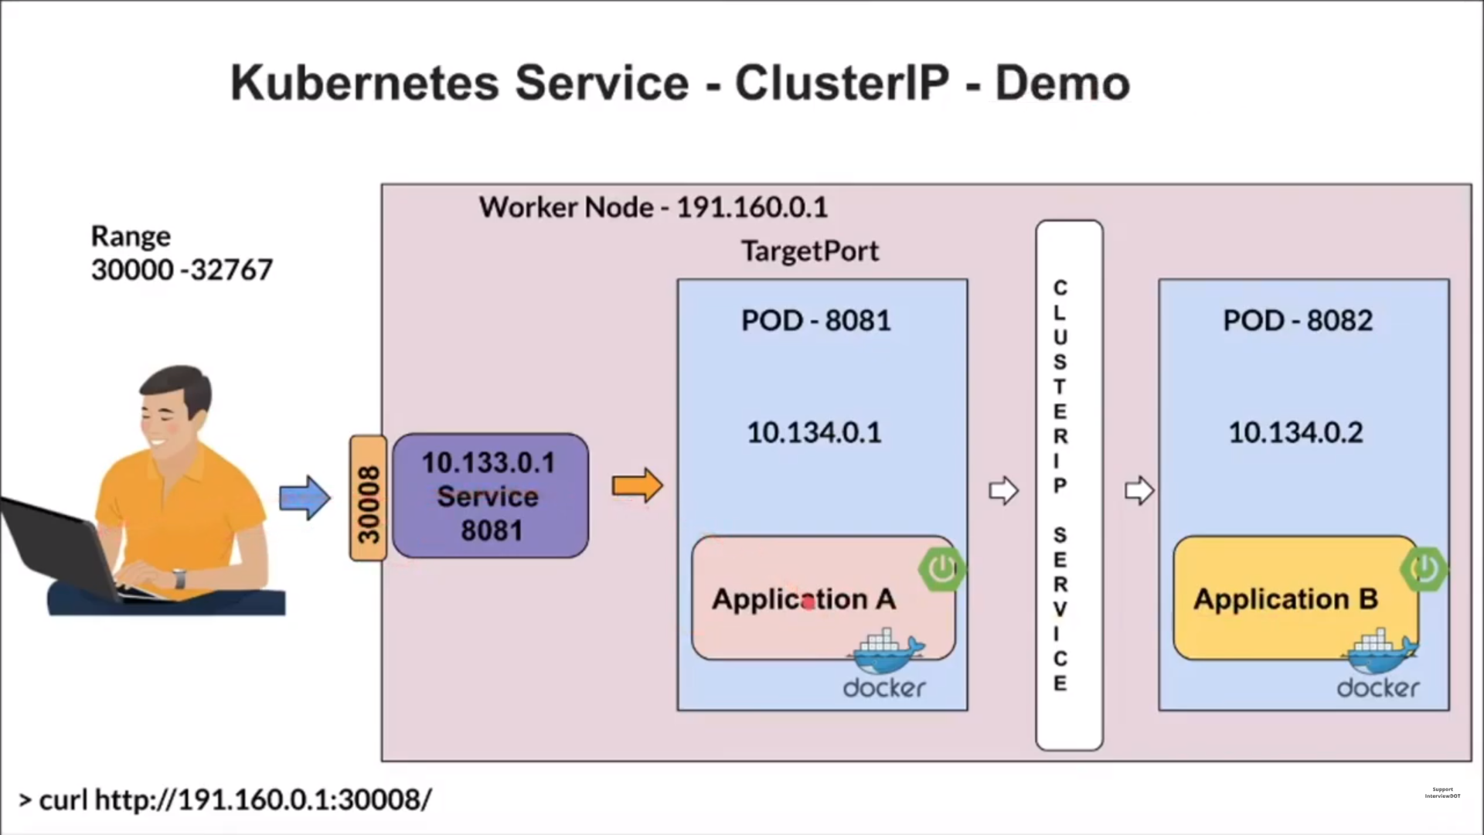

Slide 33
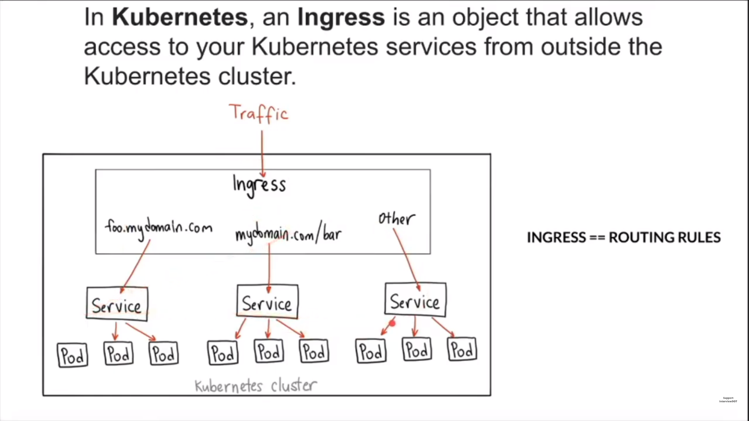

Slide 34
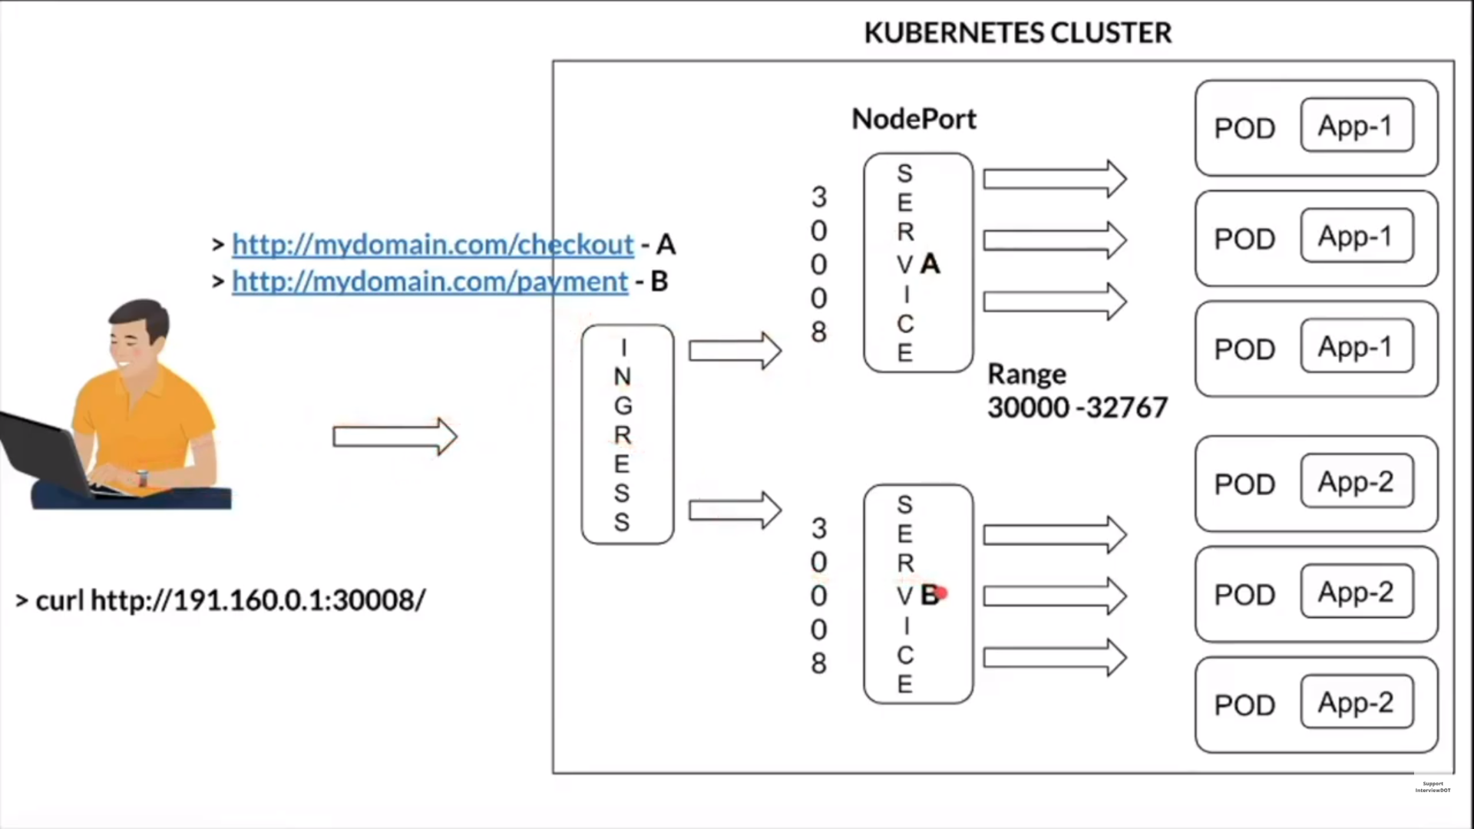

Slide 35
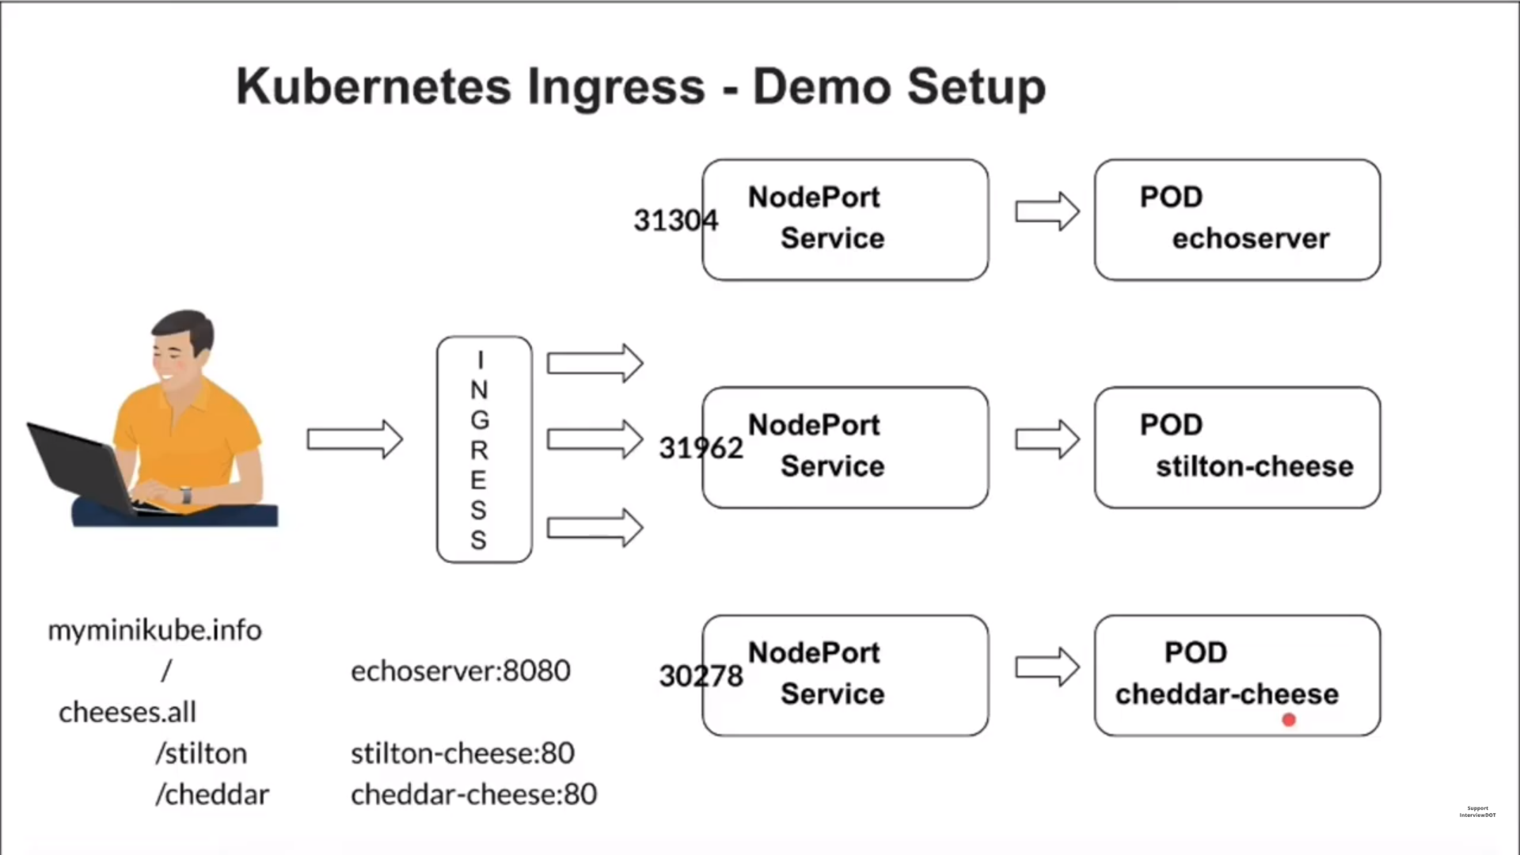

Slide 36
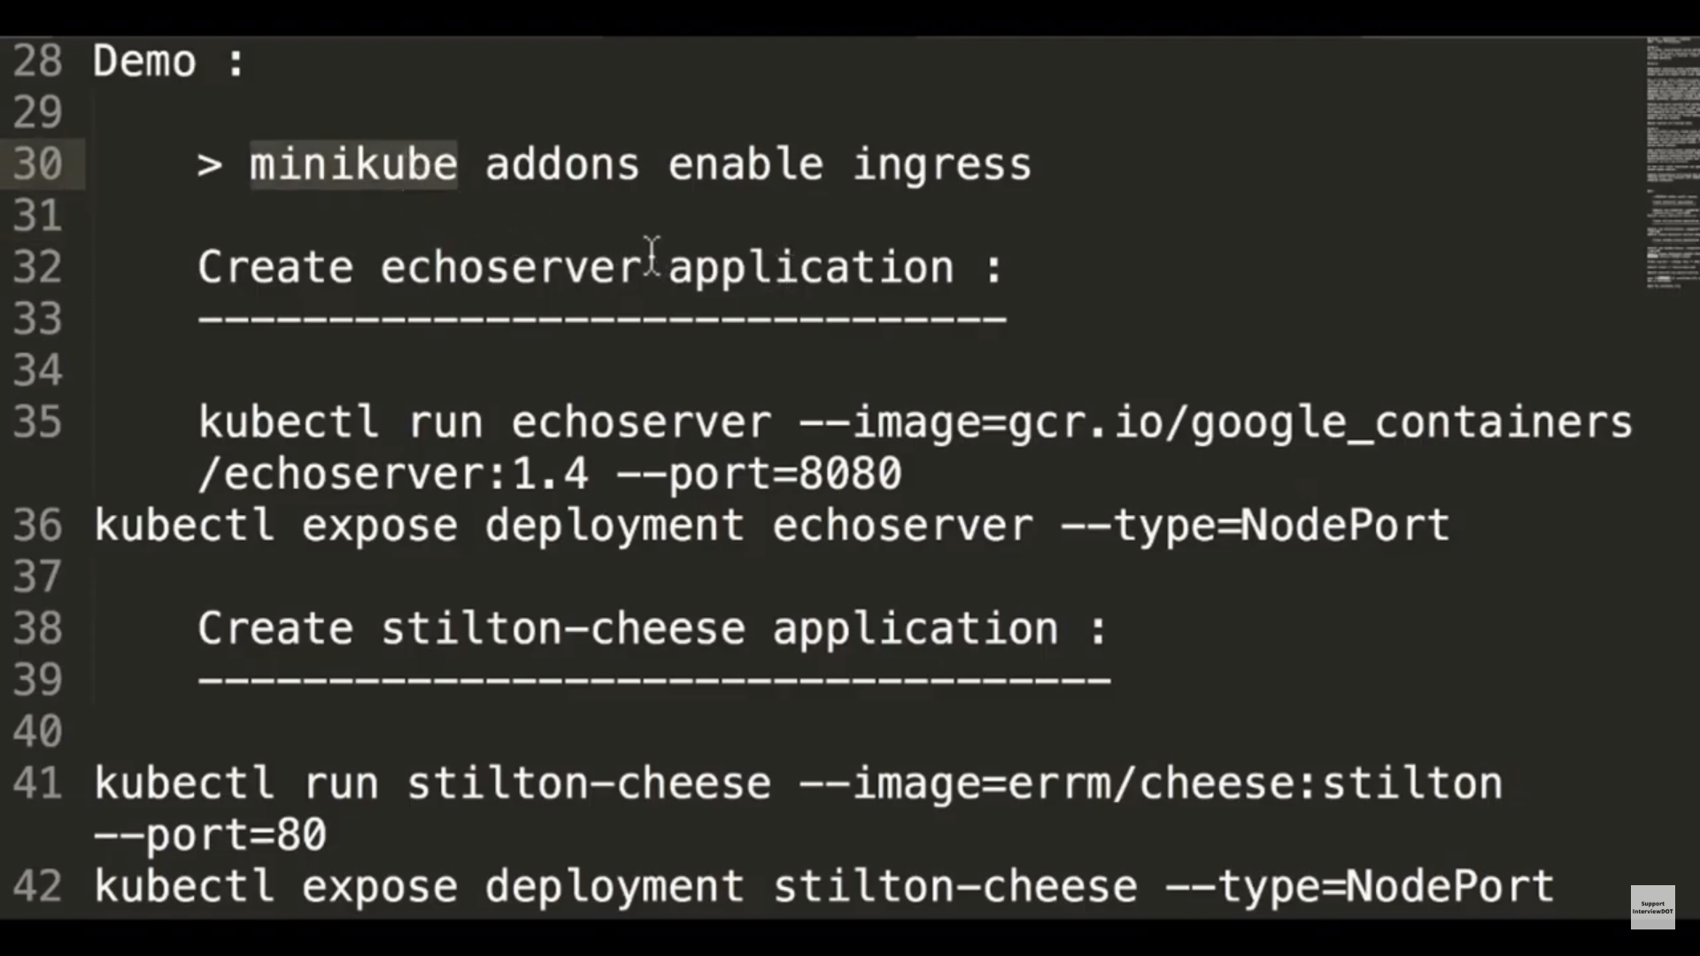

Slide 37
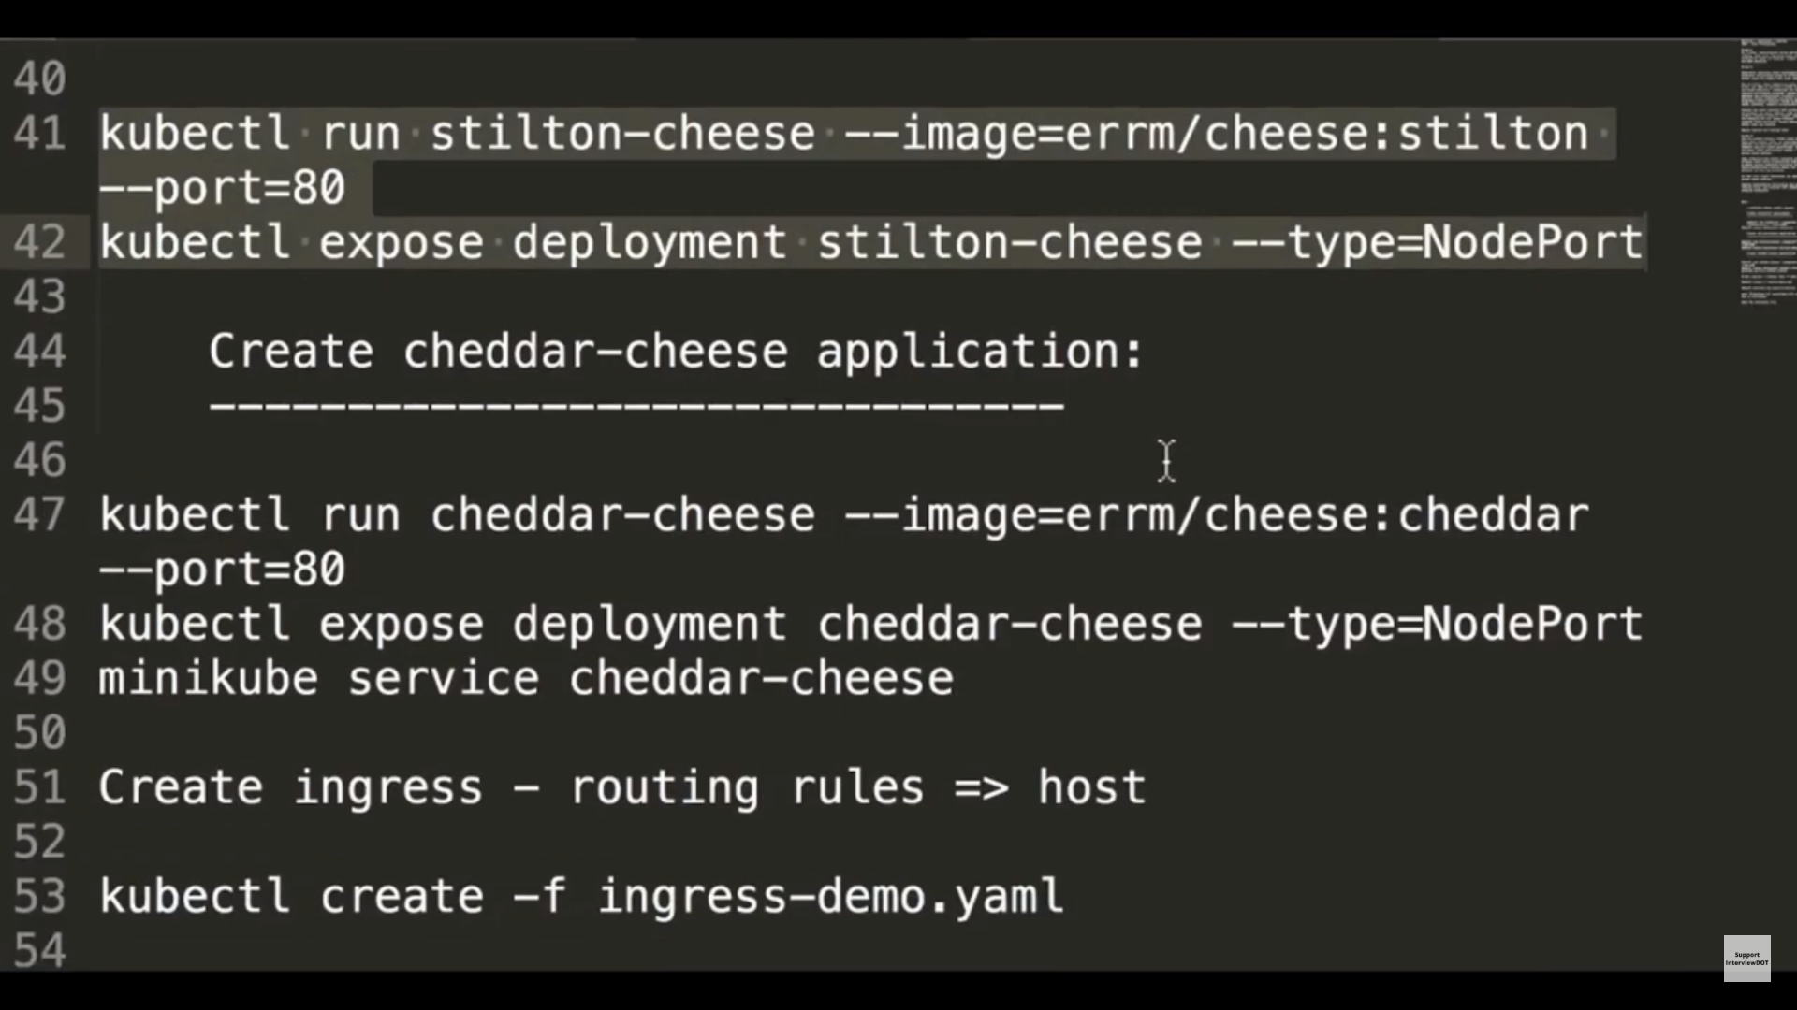

Slide 38
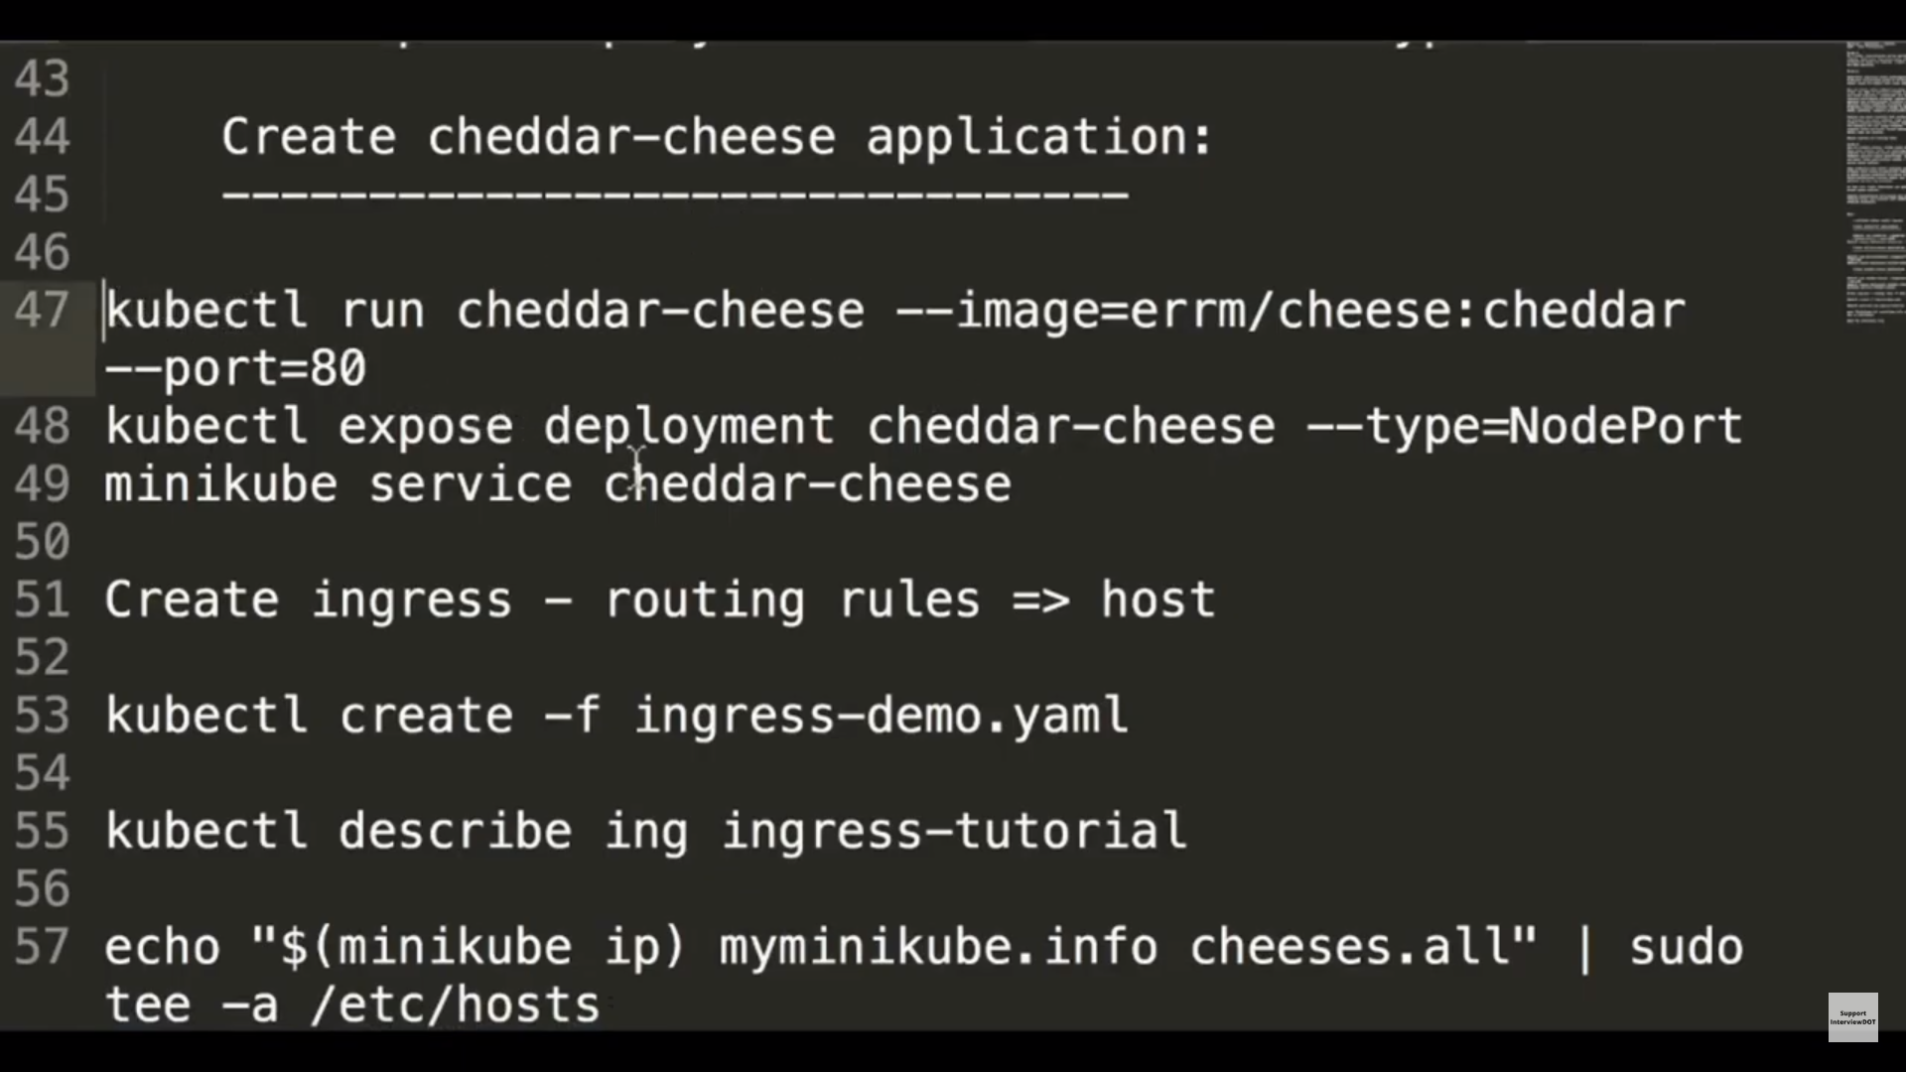

Slide 39
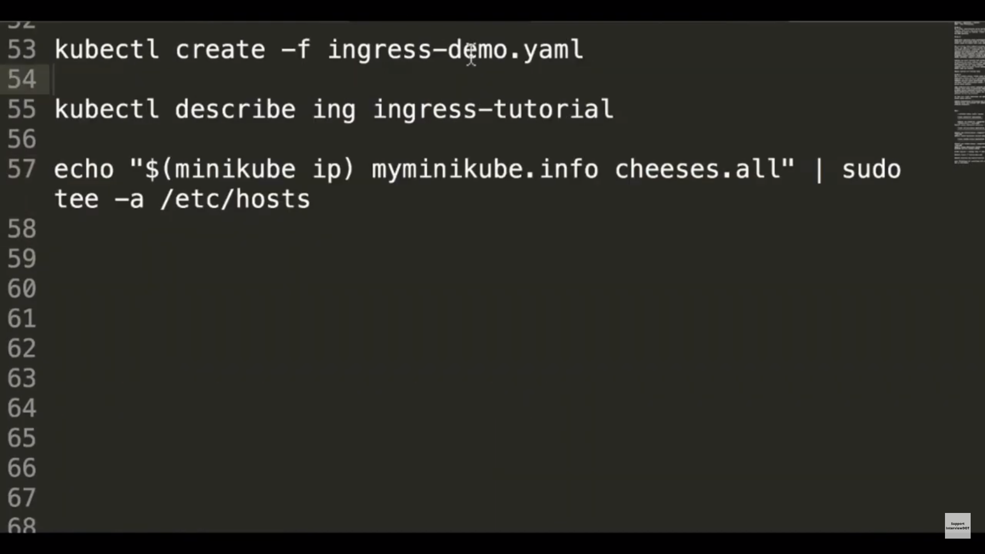

Slide 40
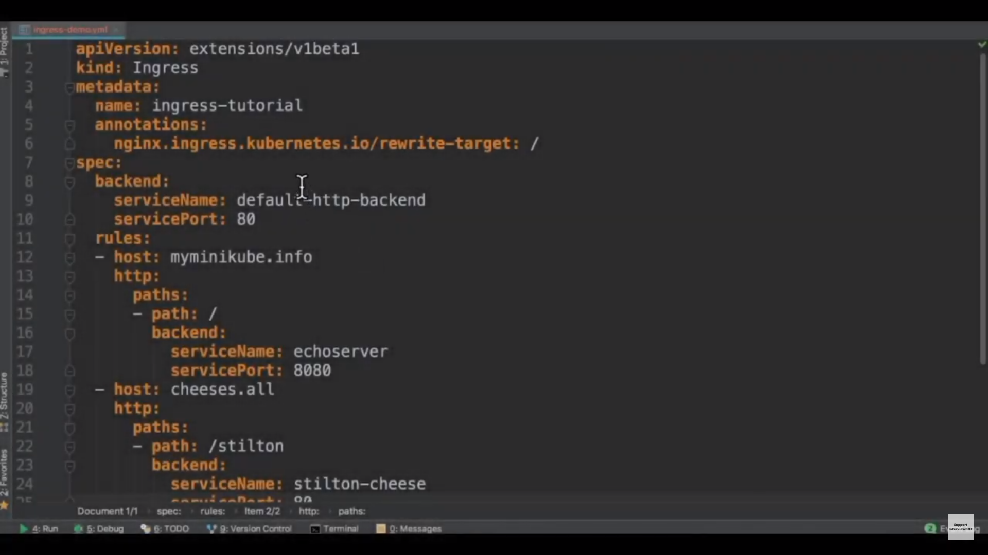

Slide 41
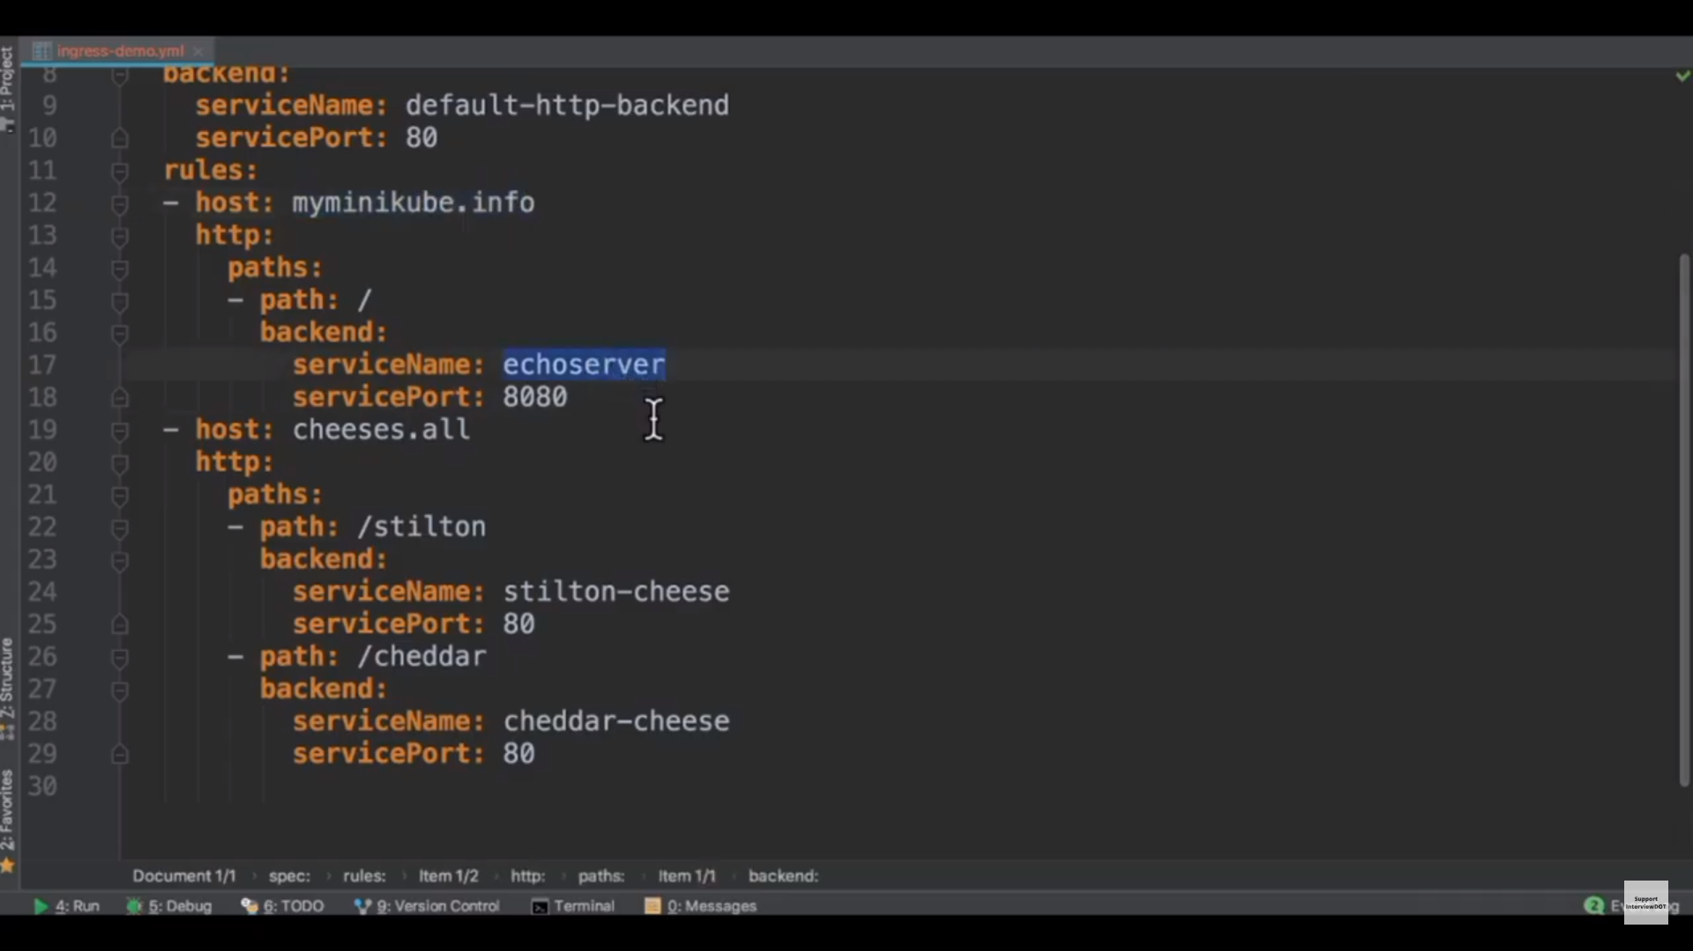

Slide 42
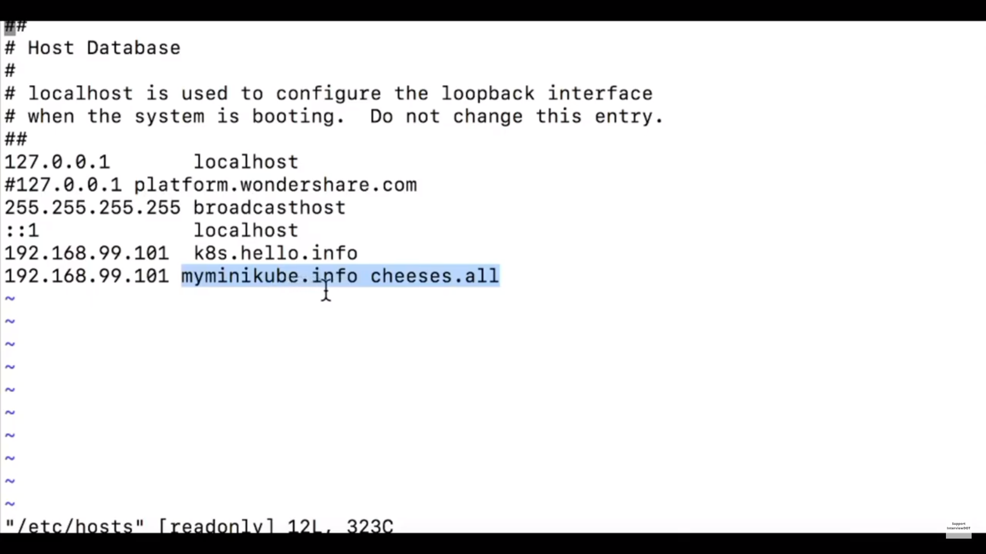

Slide 43
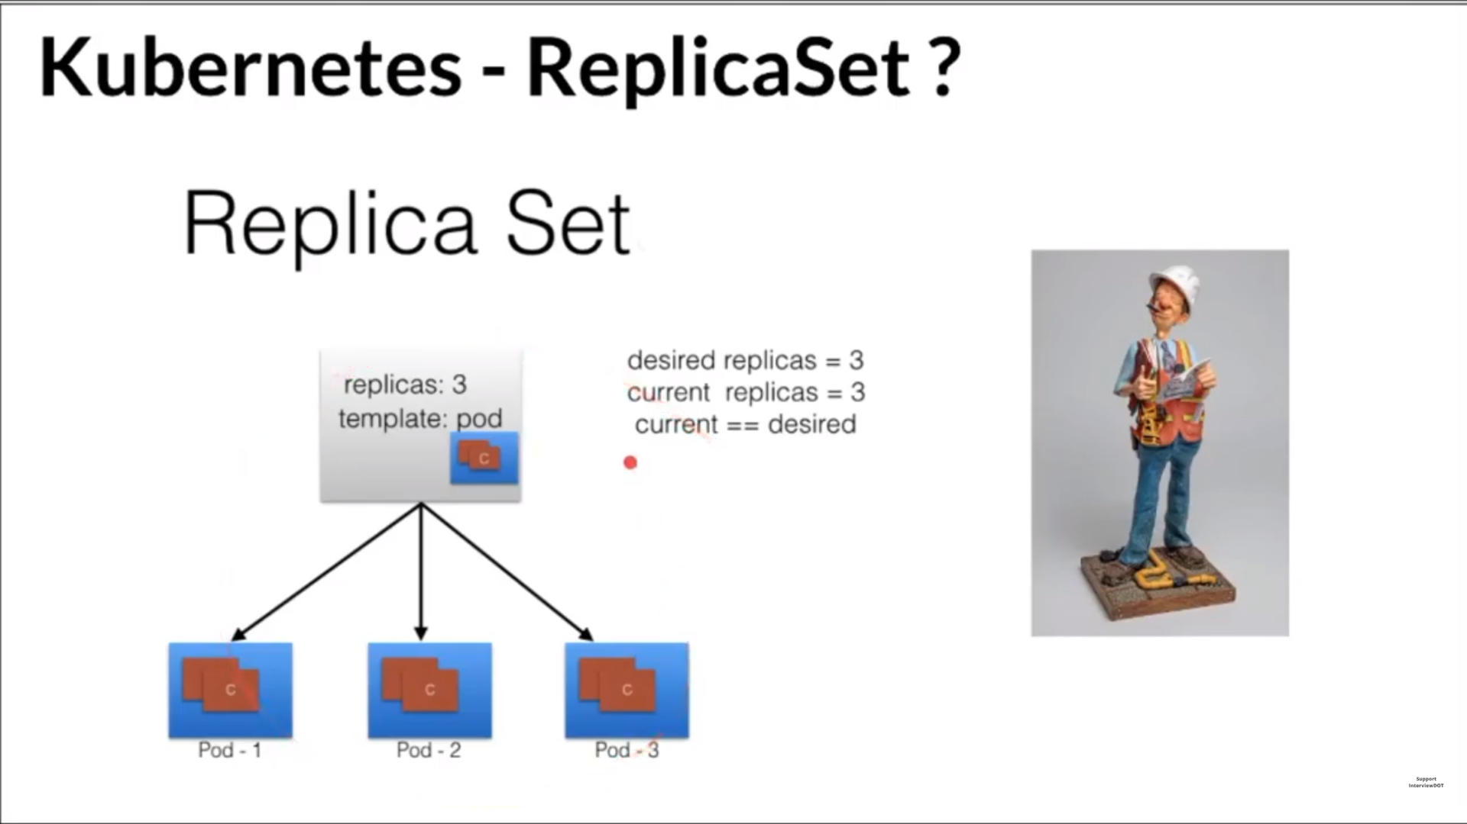

Slide 44
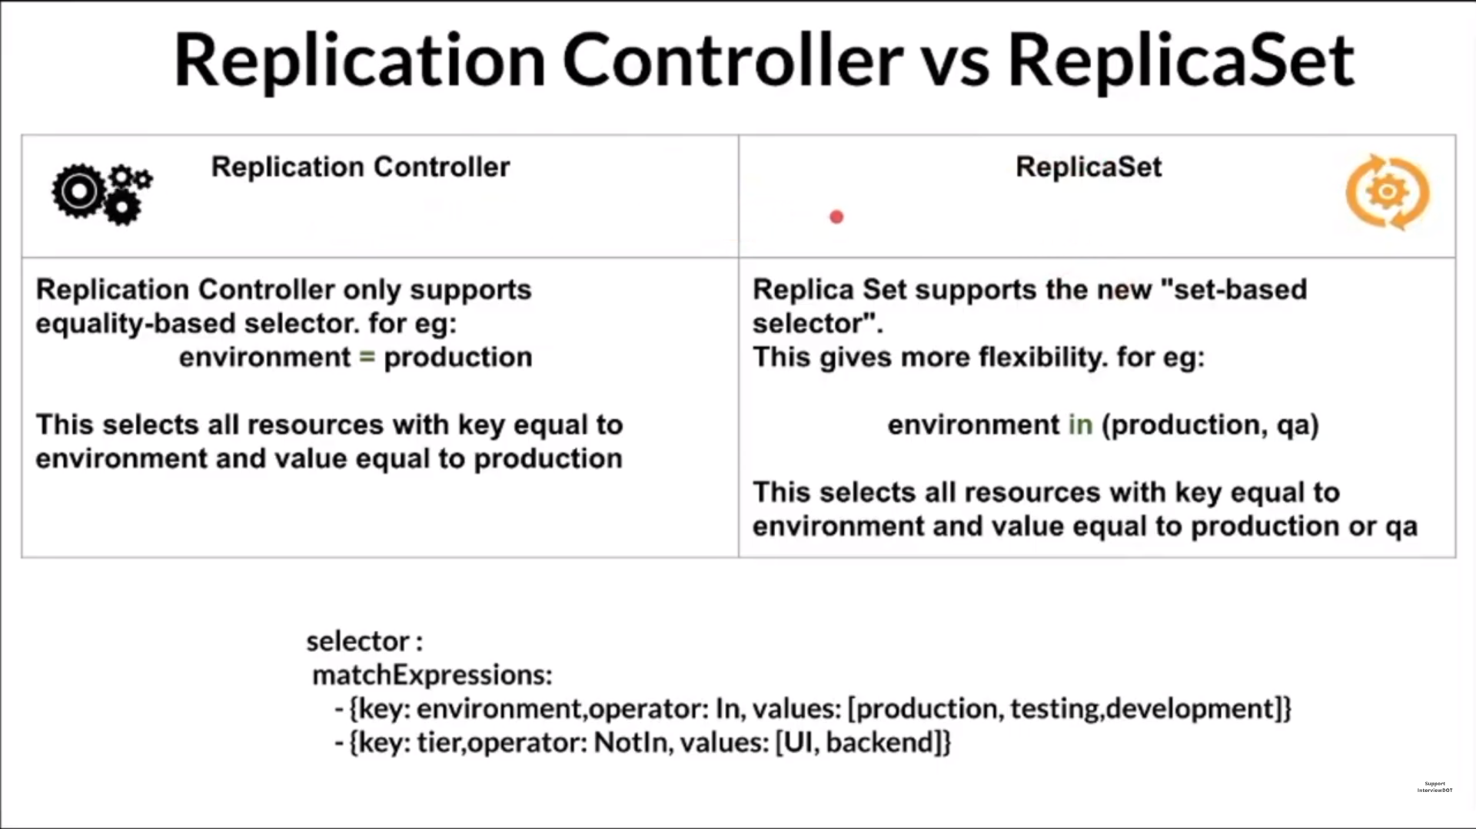

Slide 45
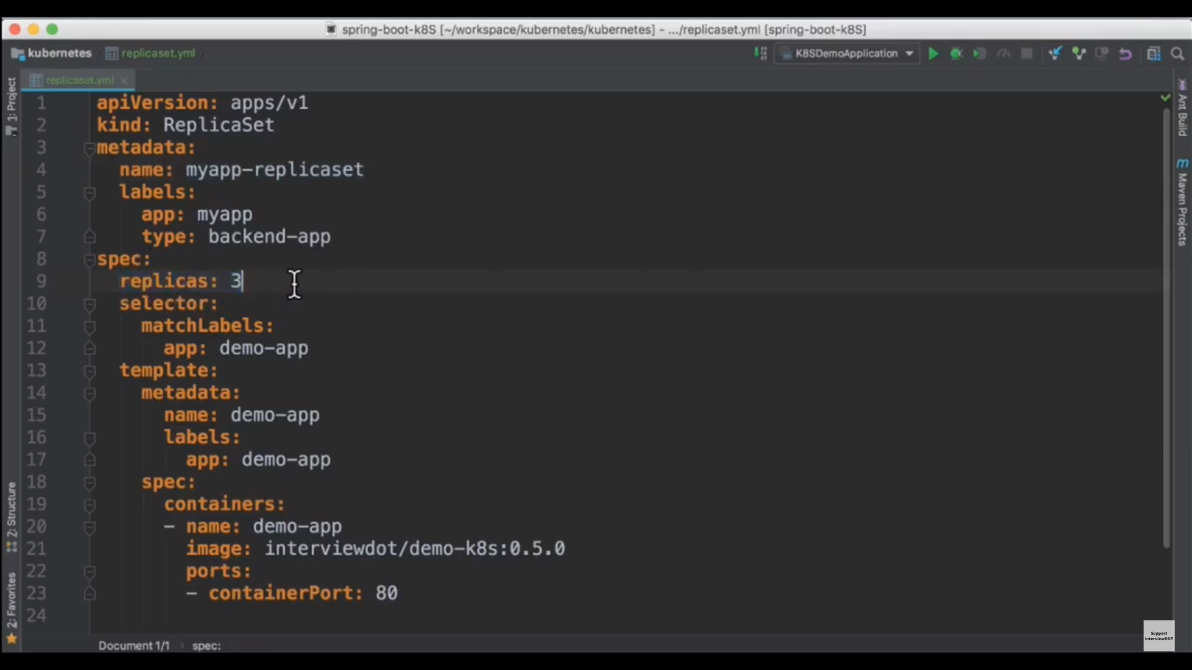

Slide 46
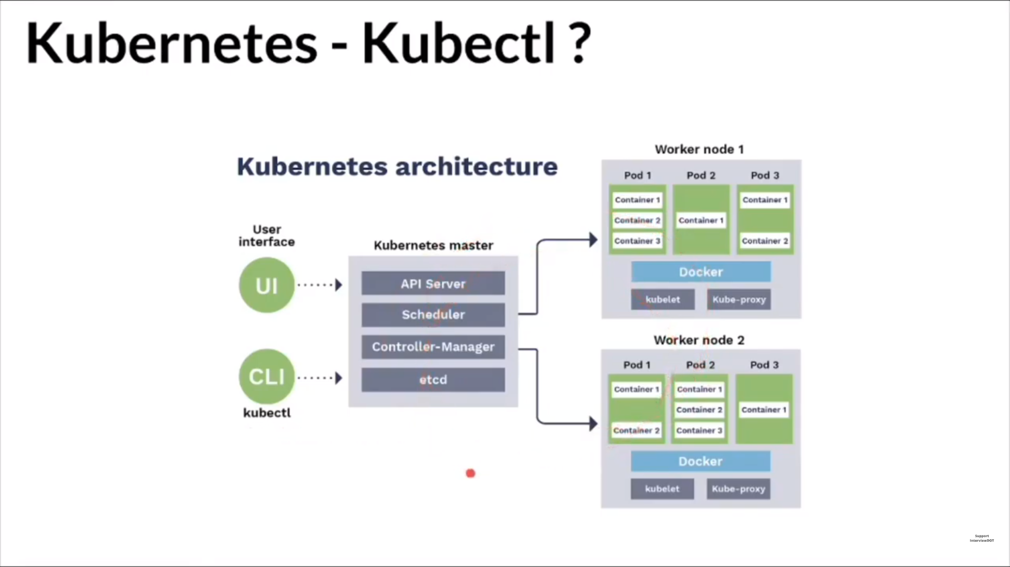

Slide 47
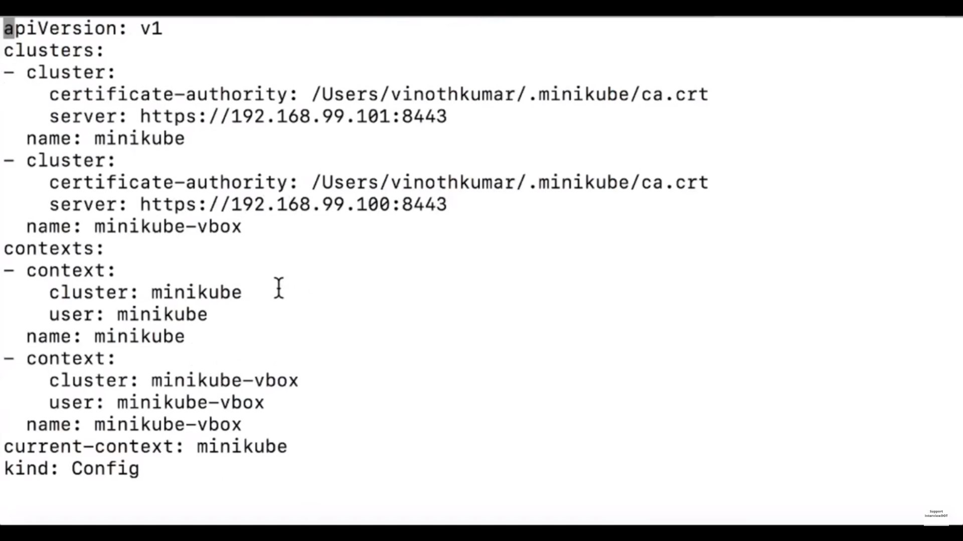

Slide 48
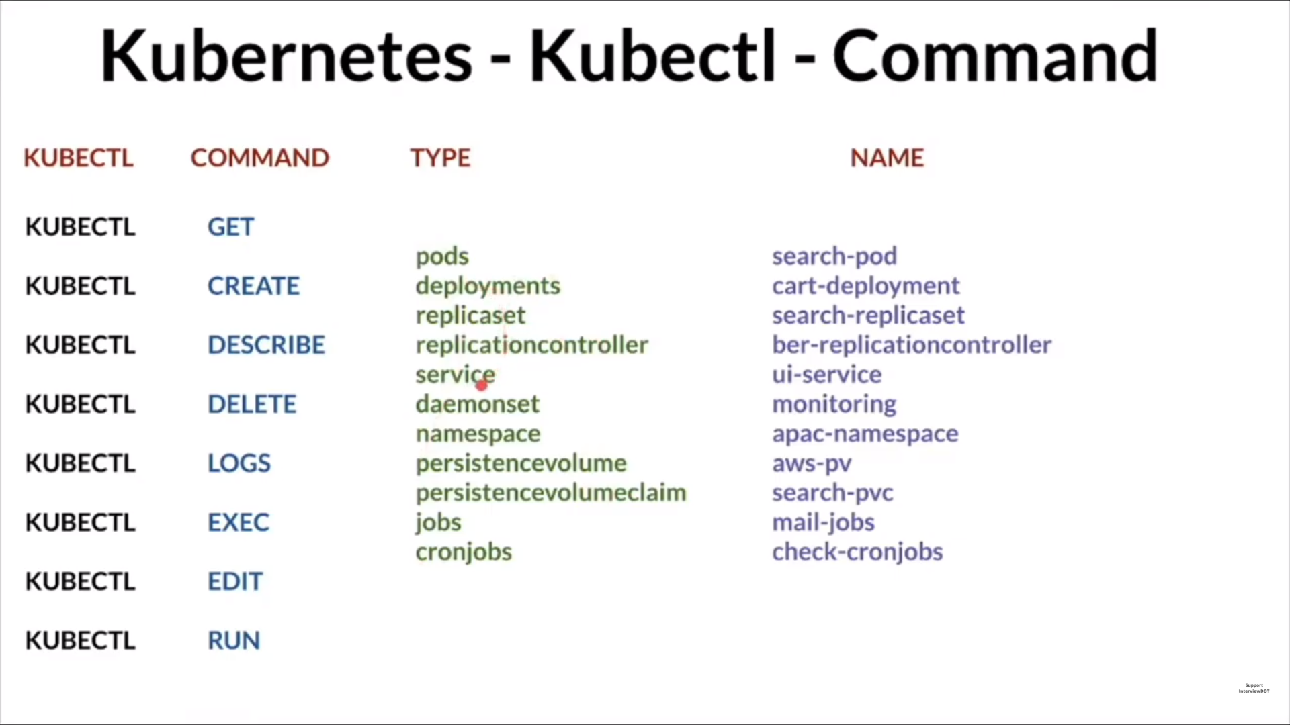

Slide 49
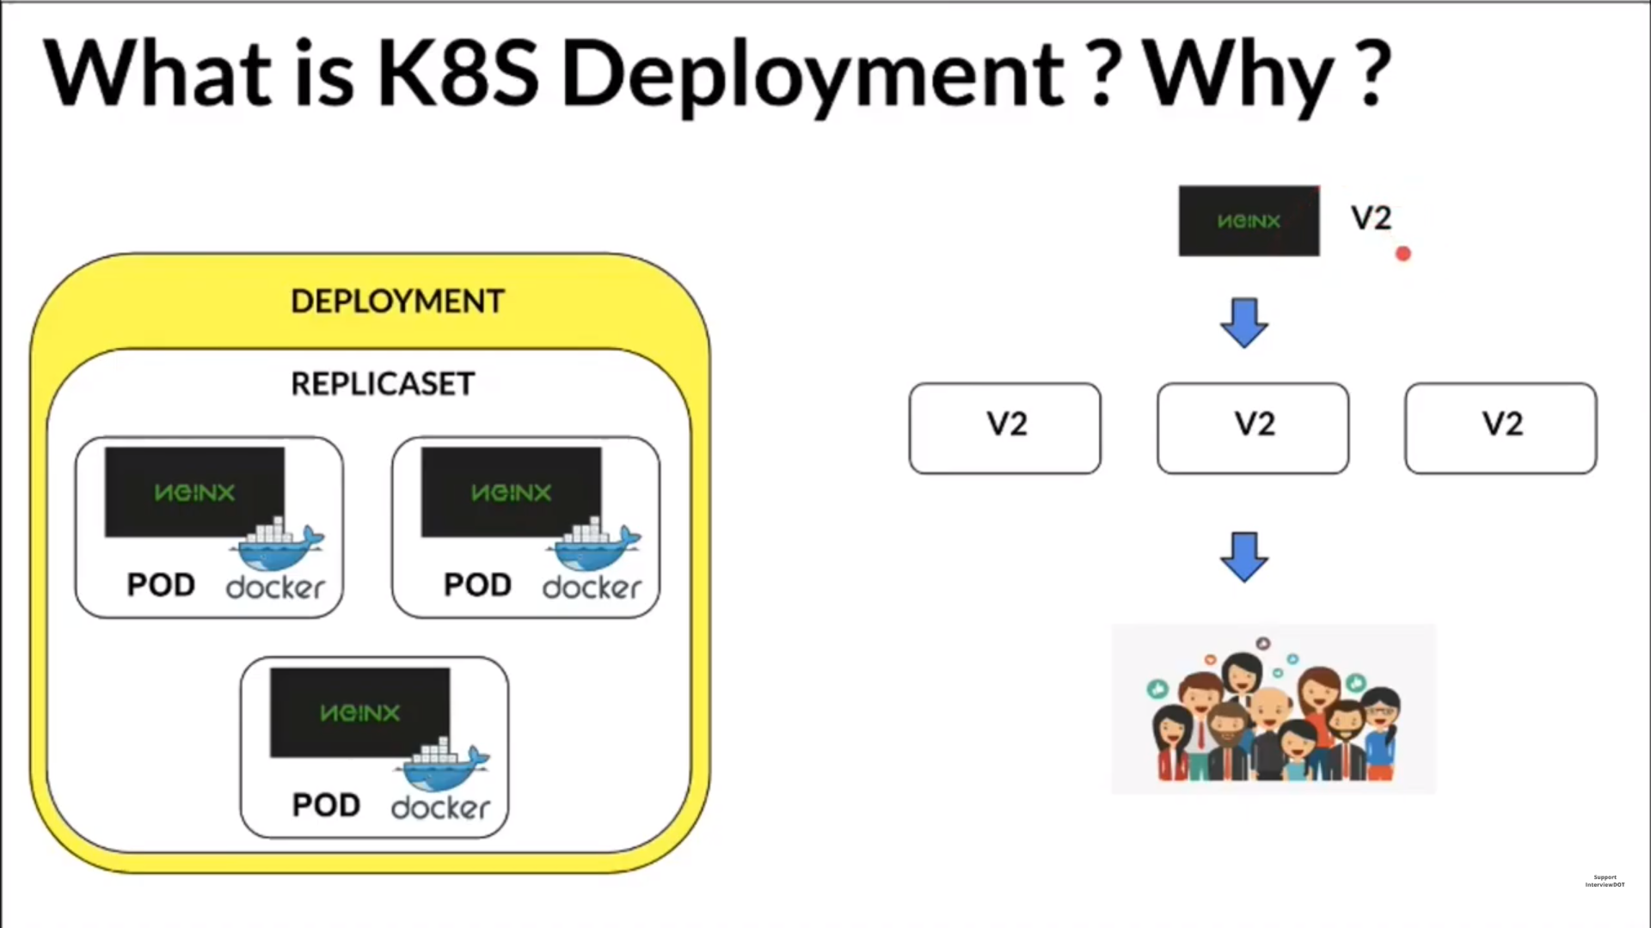

Slide 50
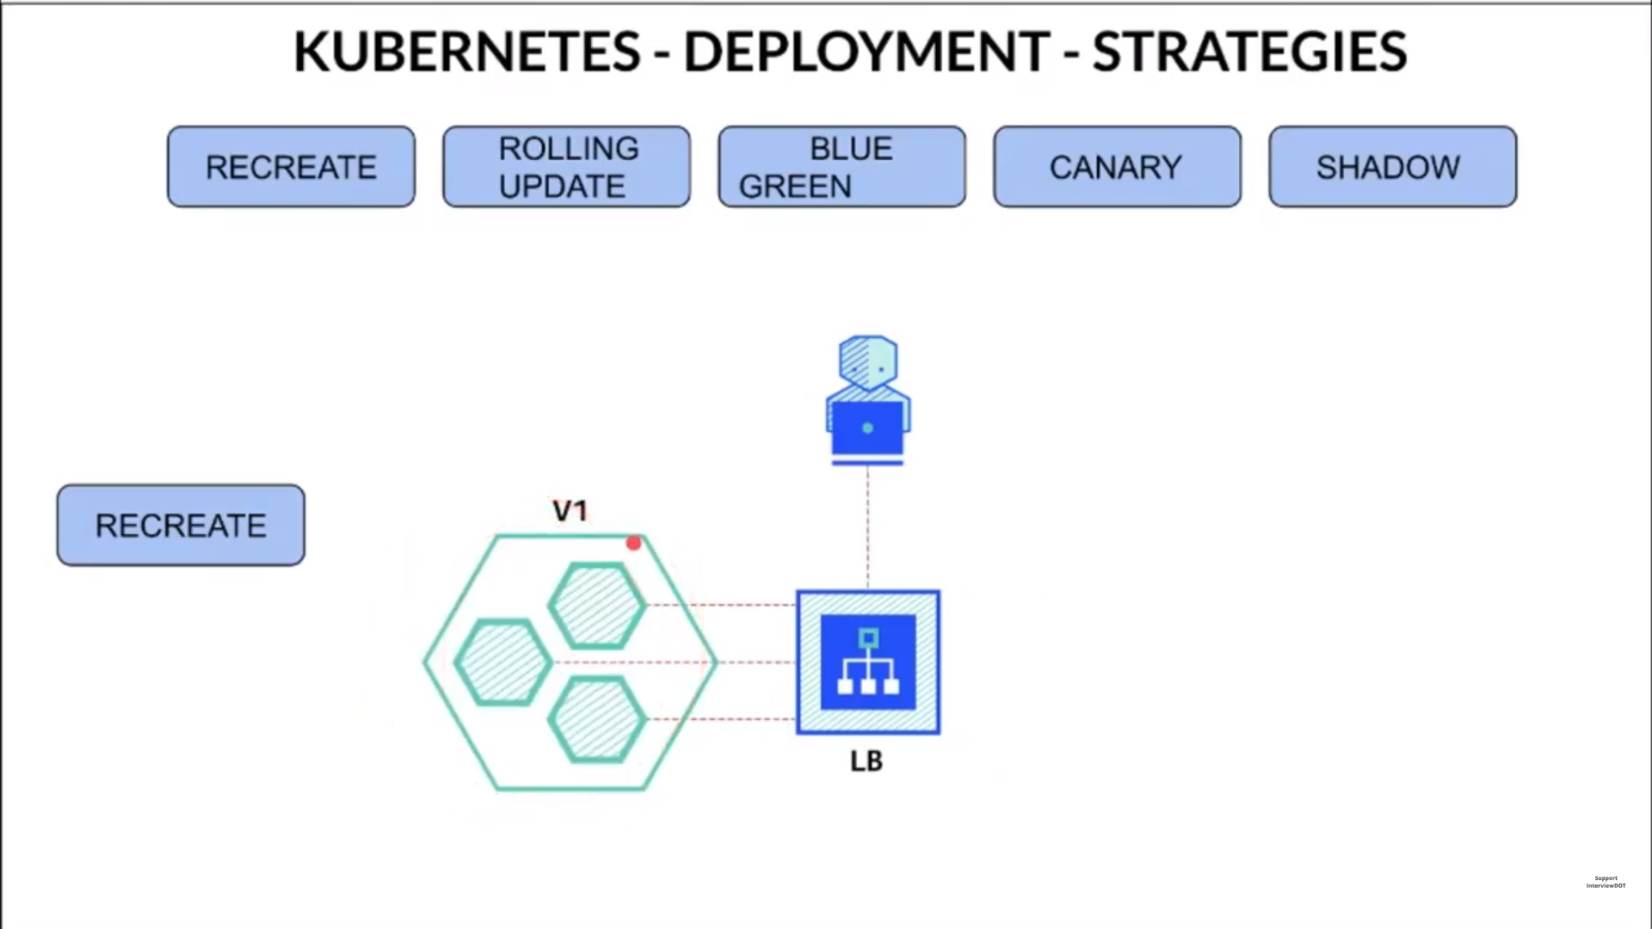

Slide 51
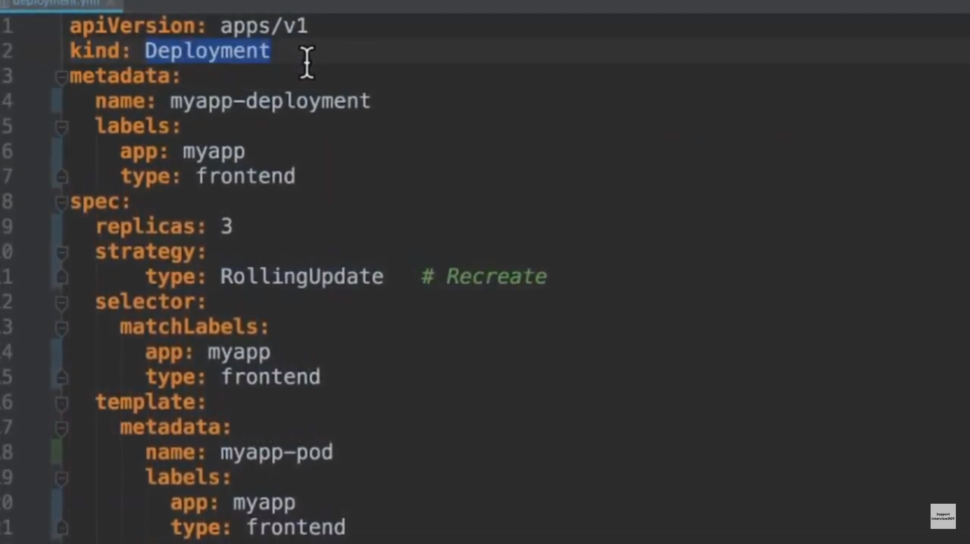

Slide 52
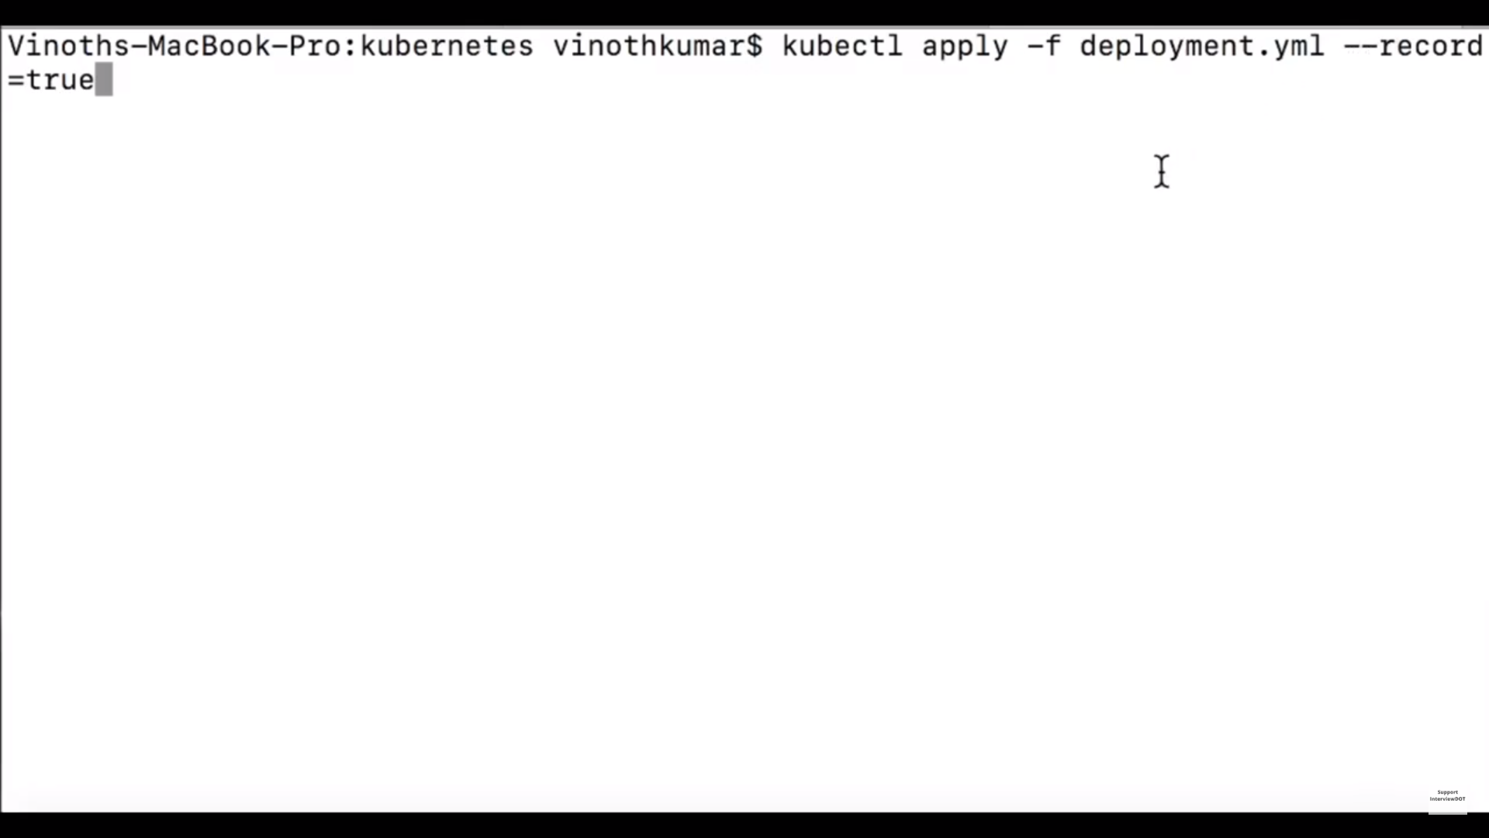

Slide 53
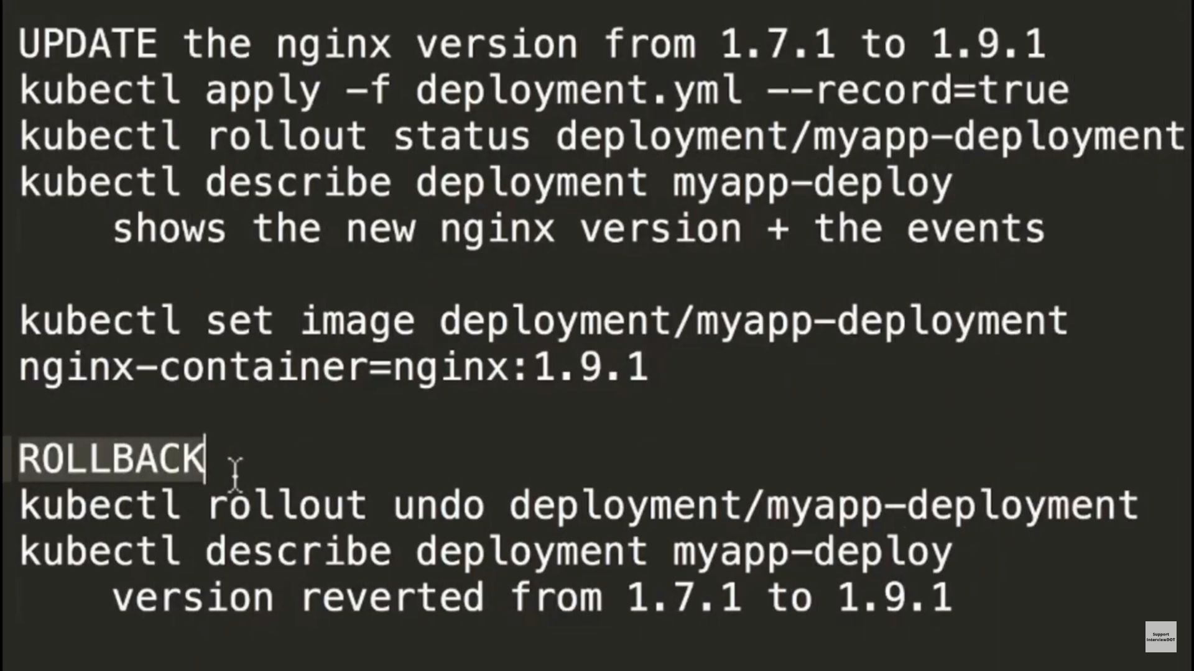

Slide 54
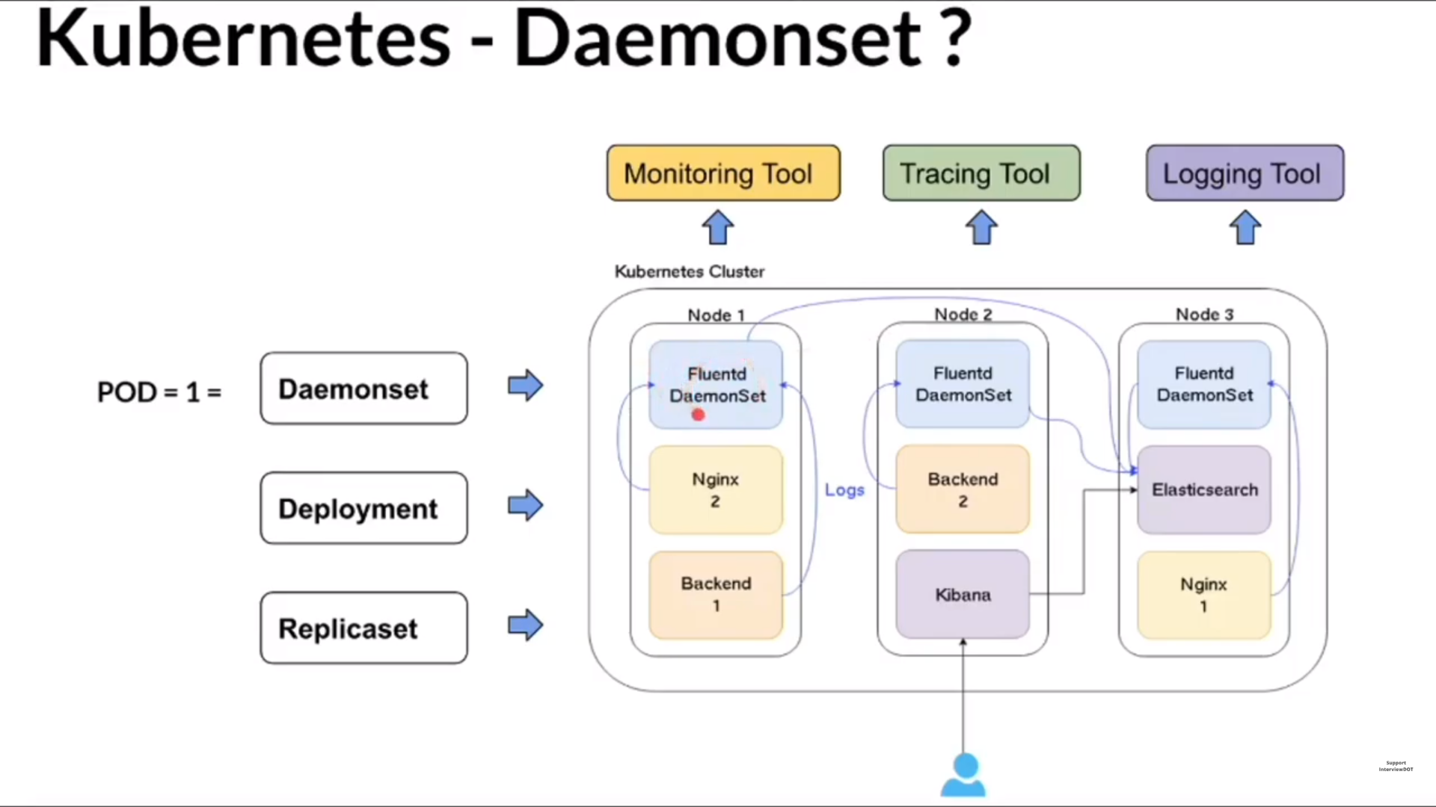

Slide 55
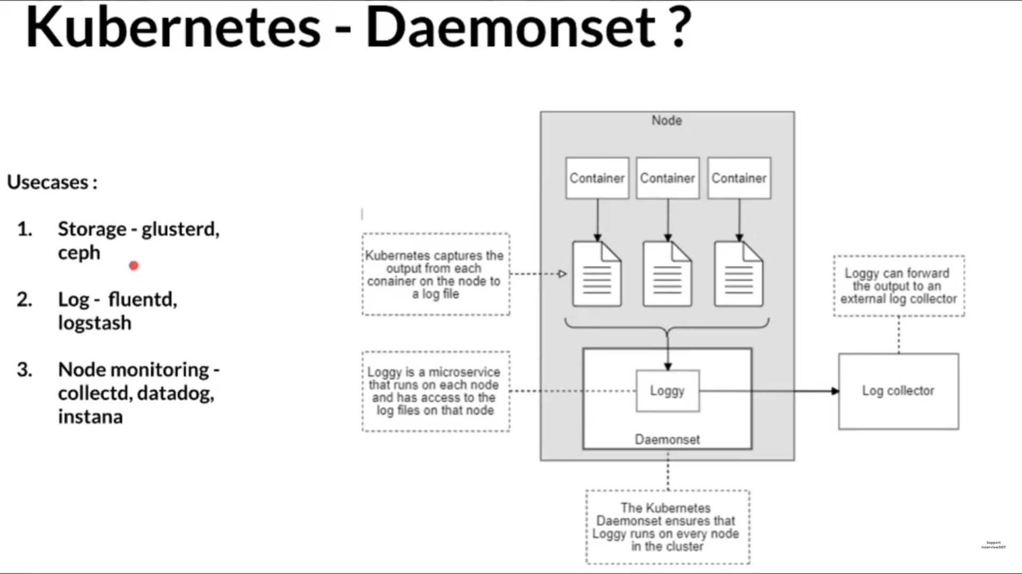

Slide 56
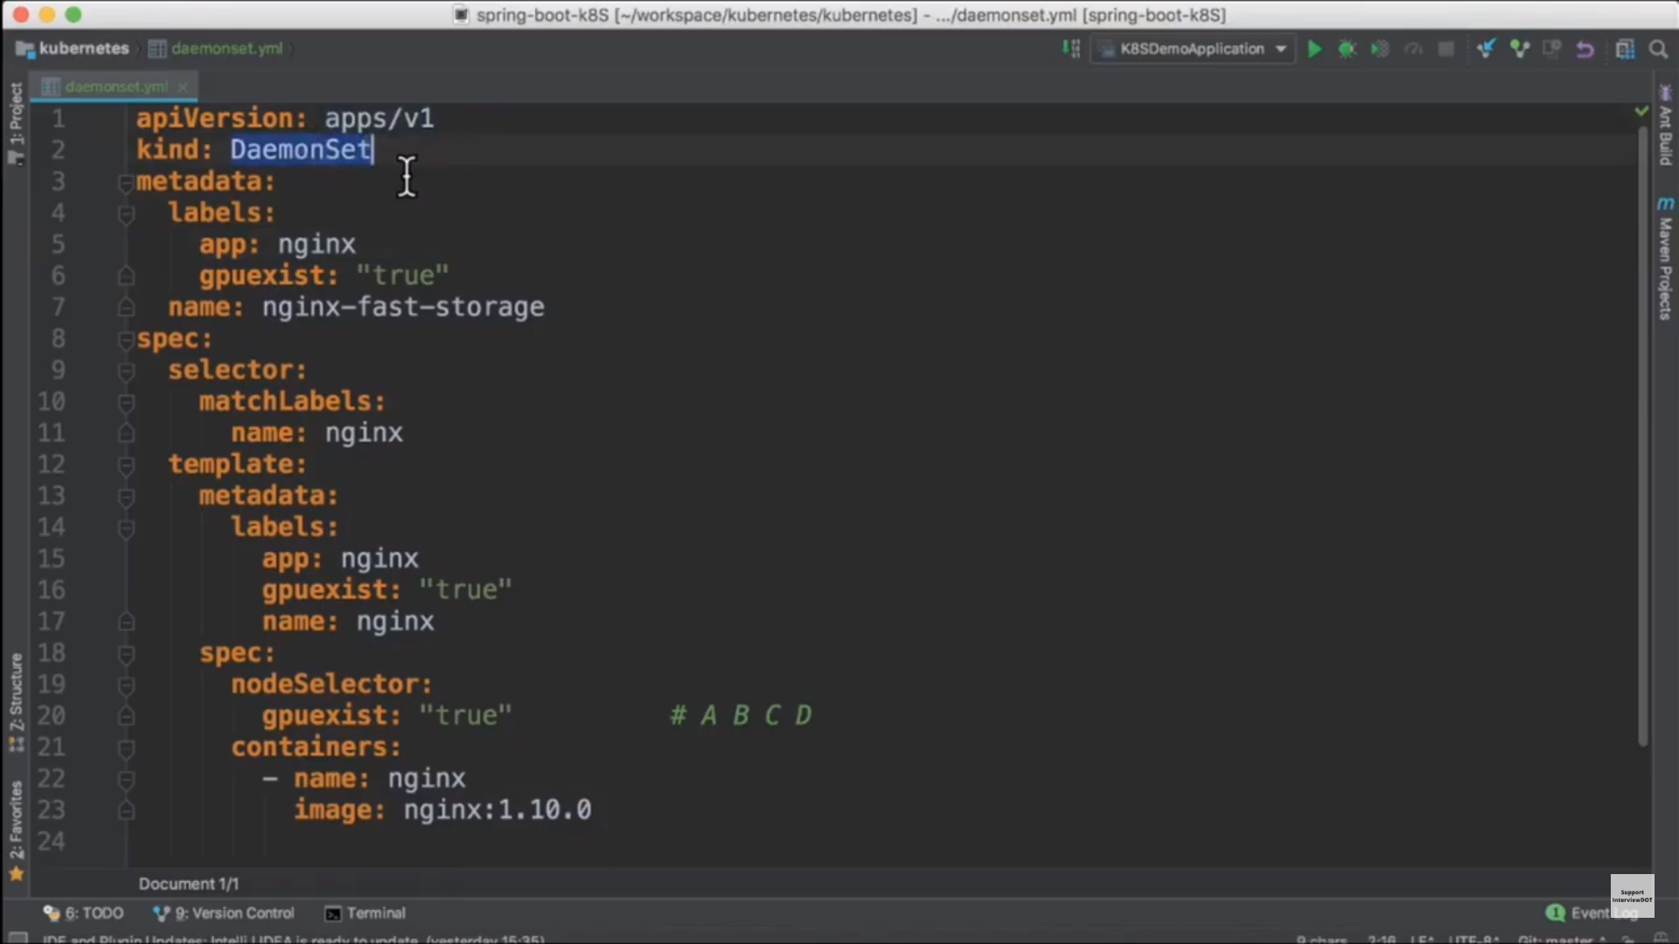

Slide 57
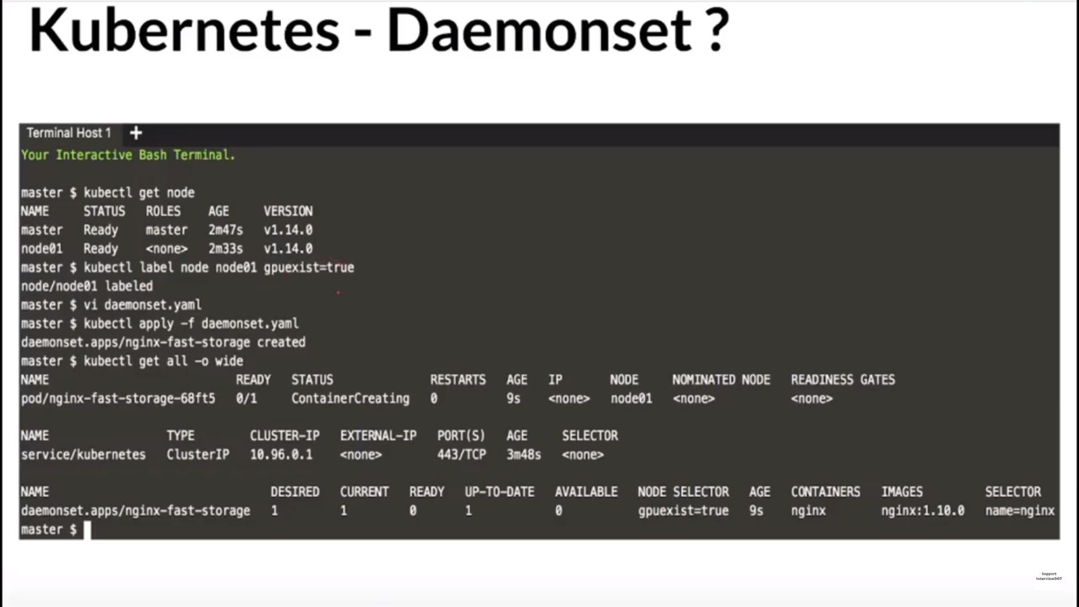

Slide 58
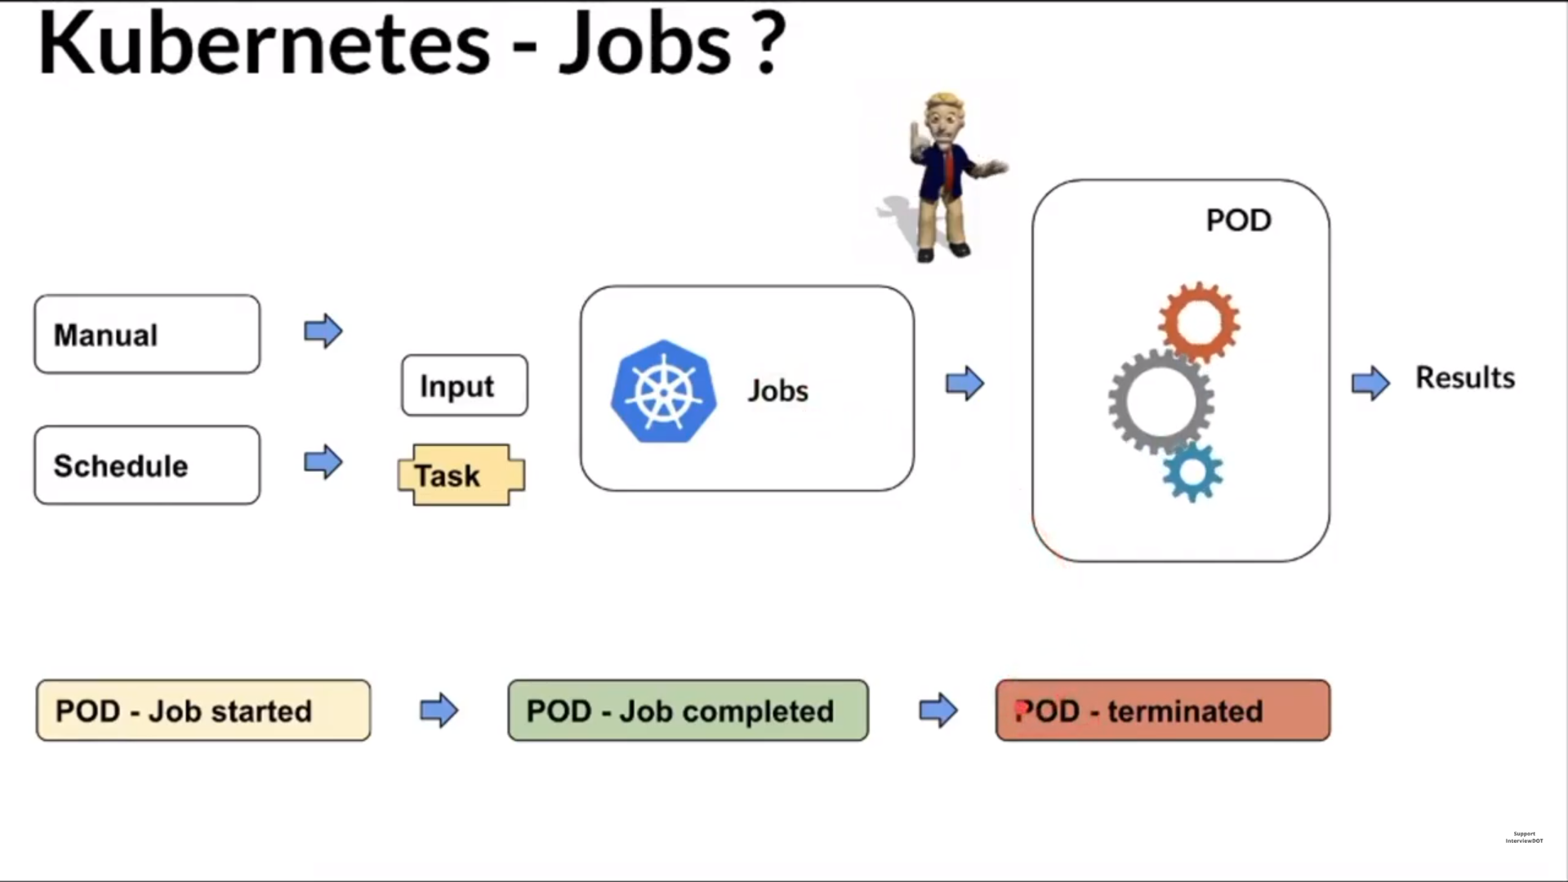

Slide 59


Slide 60


Slide 61



Slide 62


Slide 63


Slide 64


Slide 65


Slide 66


Slide 67


Slide 68


Slide 69


Slide 70


Slide 71


Slide 72



Slide 75


Slide 76


Slide 77


Slide 78


Slide 79


Slide 80


Slide 81


Slide 82


Slide 83


Slide 84


Slide 85


Slide 86


Slide 87


Slide 88
https://platform9.com/blog/kubernetes-service-mesh-a-comparison-of-istio-linkerd-and-consul/

Slide 89


Slide 90


Slide 91


Slide 92
ENVOY IS AN OPEN SOURCE EDGE AND SERVICE PROXY, DESIGNED FOR CLOUD-NATIVE APPLICATIONS

Slide 93

https://prometheus.io/

